Slide 1
How’s your grade?
Have you calculated your grade lately?
If not, use the spreadsheet
Are all your assignment listed in PAL?
You need to let me know if they are not

Slide 2
Chemistry Of Life

Slide 3
Matter
Has Mass
Takes up space (volume)
Made of atoms

Slide 4
Elements
Elements are chemicals in their pure form; i.e. not combined with anything else
25 essential elements (ones needed for life)
Carbon, hydrogen, oxygen and nitrogen make up 96% of living organisms
Elements cannot be broken down into simpler chemicals through chemical methods

Slide 5
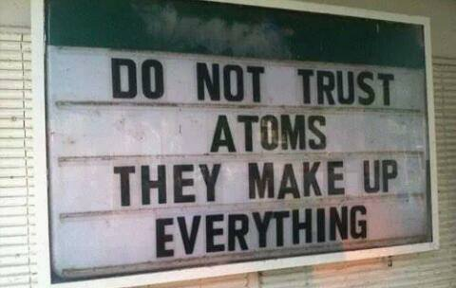
Atom
All matter made of atoms
Greek ἄτομος (atomos, "indivisible")
Smallest amount of an element that still has normal chemical properties
We can split atoms, but they loose their chemical properties, and it takes a lot of energy

Slide 6
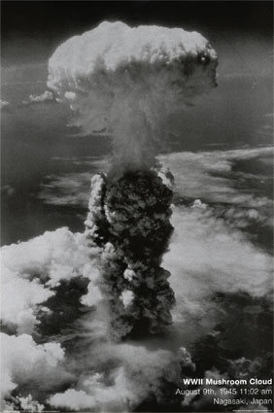
….and can be a messy process

Slide 7
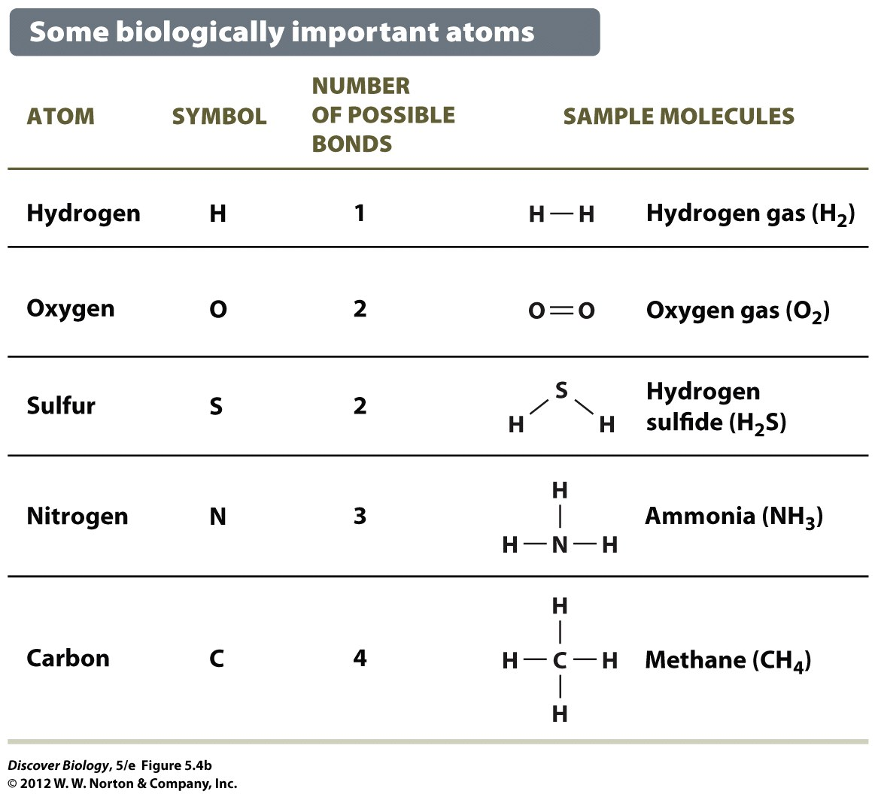
Atoms
The smallest piece of an element that has the same chemical properties as larger amounts of the element would

Slide 8
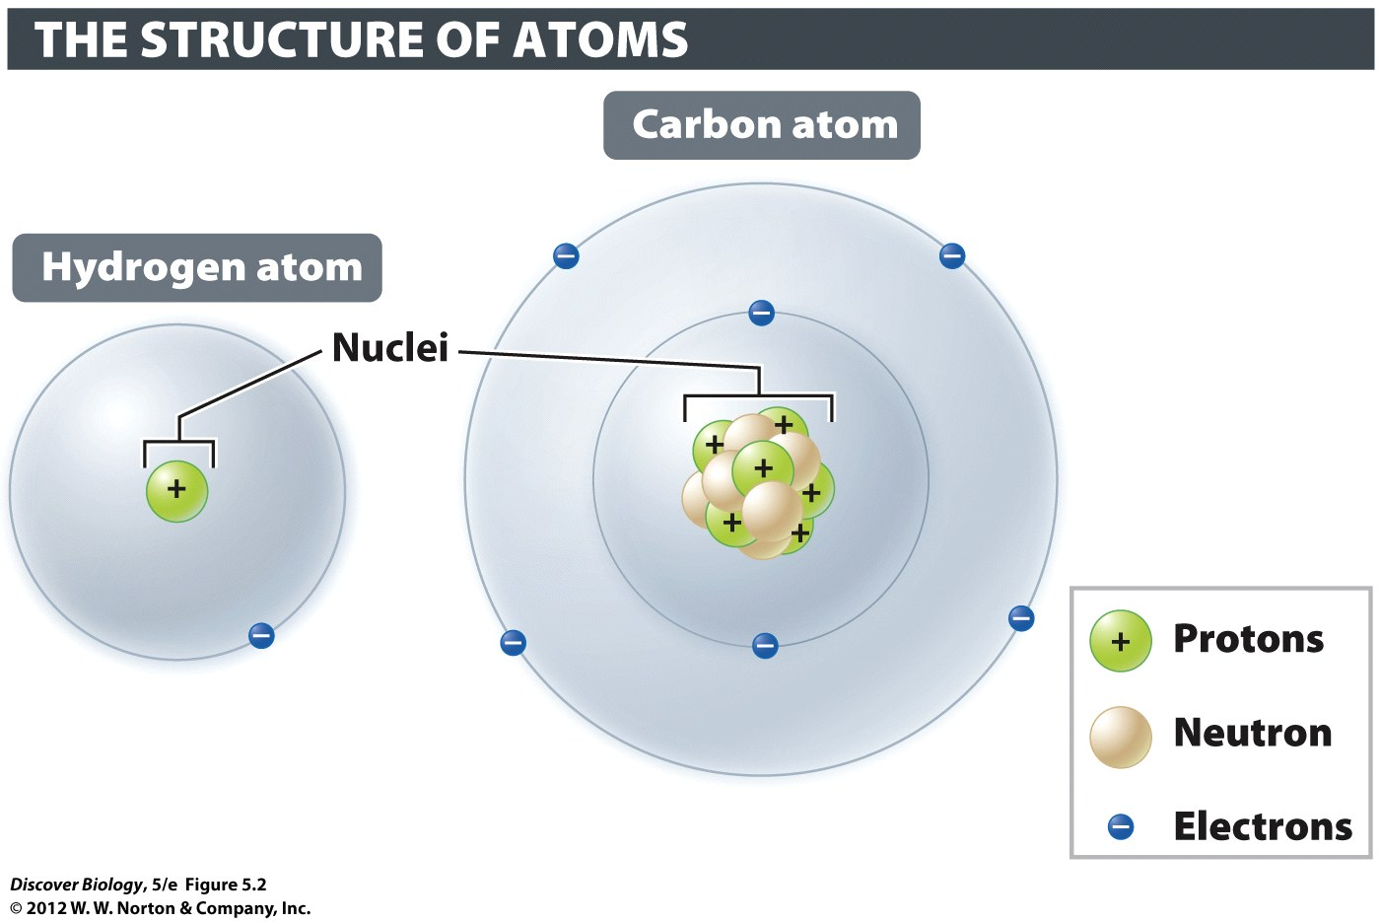
Subatomic Particles
Only three last long enough to matter us
most atoms are neutral: protons = electrons

Slide 9
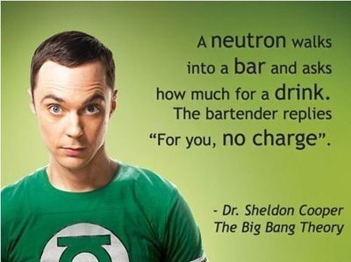

Slide 10
“Atomic Number” = number of protons
The atomic number determines what type of element an atom is. All atoms of carbon have six for their atomic number. All atoms of oxygen have eight protons. The atomic number never changes in nature.
(alchemist doesn’t know this➔

Slide 11
Isotopes
Isotopes are versions of atoms with different weights. All isotopes of an element have the same number of protons (that’s why they are the same element)
They differ from other isotopes of the element because they have a different number of neutrons

Slide 12
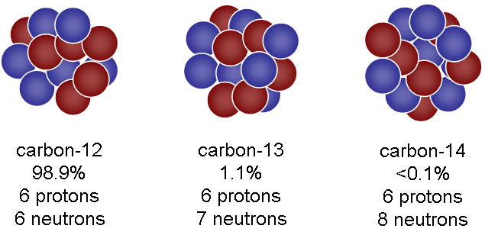
The number of neutrons is different in different isotopes. That gives different isotopes different masses.
Example: C-12, C-13, C-14

Slide 13
Some isotopes are unstable (Atoms of this isotope fall apart easily)
When atoms break down, part of them will become an atom of a new element, but part of them will become radioactive energy

Slide 14
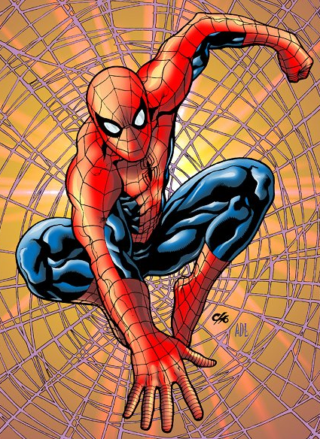
Radioactive stuff is useful!!!
(but not this way)

Slide 15
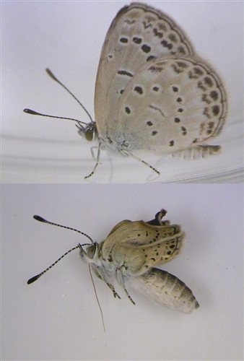
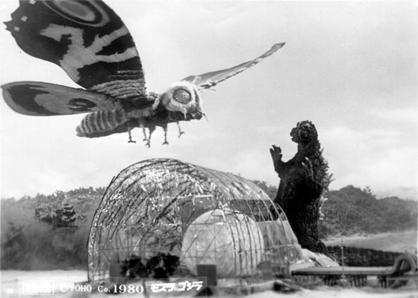
Mutant Butterfies in Japan

Slide 16
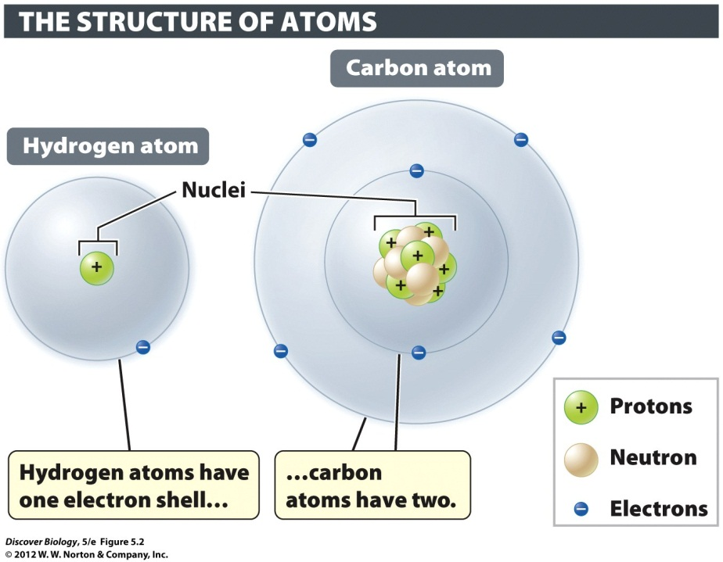
Energy Levels of Electrons
Around the nucleus
in layers like onion
Layers = “shells”

Slide 17
Energy Levels of Electrons
Big orbit = more energy
“energy layer” or “electron shell”

Slide 18
Energy Levels
arrangement of electrons = chemical properties
“Valence electrons”
# of valence electrons is most important chemical property

Slide 19
Valence Electron Layers
Atoms want full, empty, or eight electrons
DO NOT WRITE LAYERS!!!!
Layer 1 = Maximum of 2
Layer 2 = Maximum of 8
Layer 3 = Maximum of 18
Layer 4 = Maximum of 32
Layer 5 = Maximum of 32
Layer 6 = Maximum of 18

Slide 21
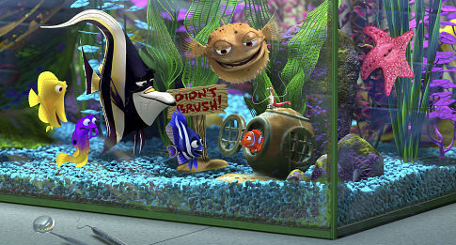

Slide 22
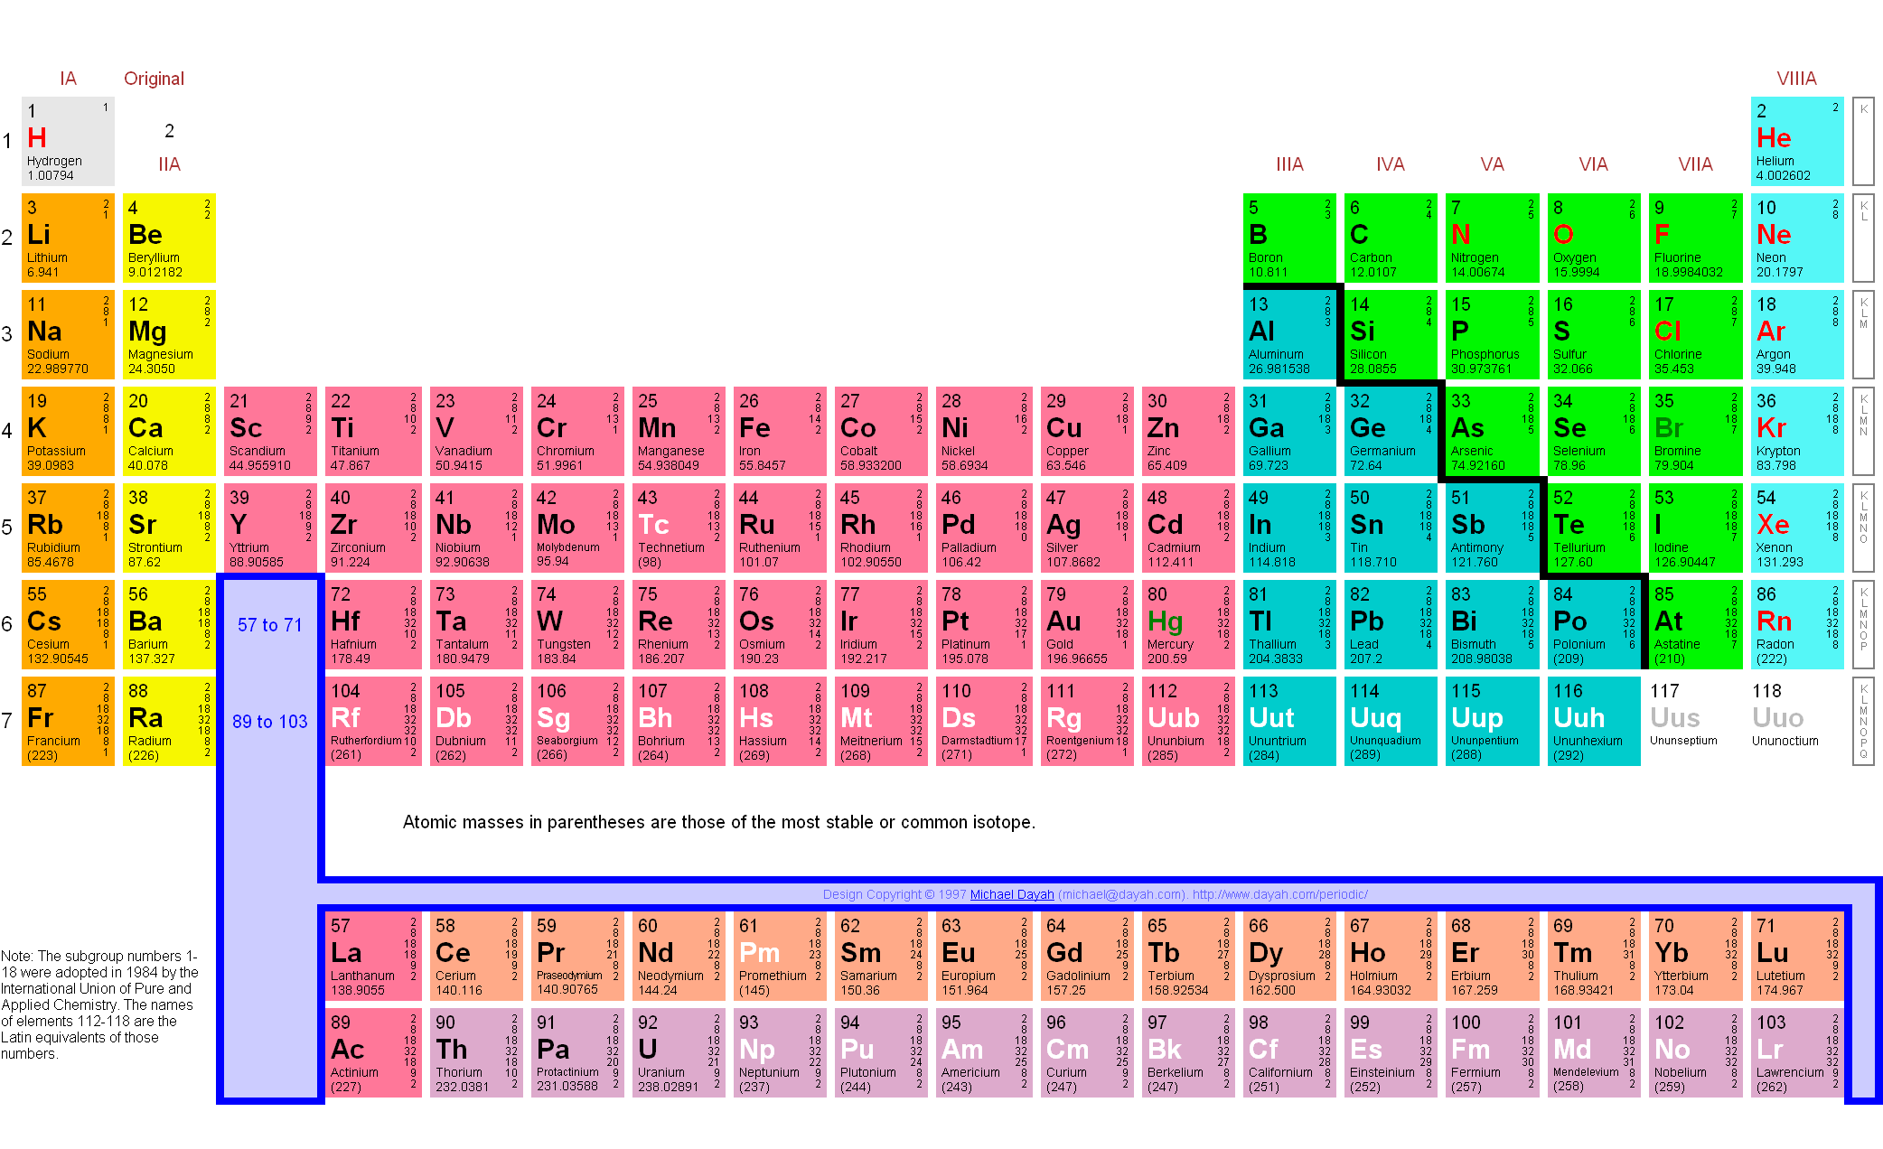

Slide 23
Mixture (vs. compound)
Mixture
Two or more substances together
Amounts may vary
Compounds (chemical bonds)
Two or more elements together
Fixed ratio (always the same ratio)
Emergent properties – behavior of compound may be drastically different than the behavior of the individual elements

Slide 24
Chemical Bonds (getting everybody to a happy valence number)
Ionic Bonds = taking or giving electrons
Covalent Bonds = sharing electrons
Weak bonds
Van Der Waals
Hydrogen bonds

Slide 25
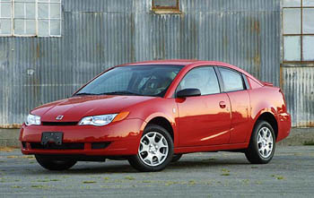
Ions: Atom with charge
most atoms are neutral: protons = electrons
If electrons != protons, atom has charge, and we call it an “ion”
not one of these ➔
(you knew I would make a car joke)

Slide 26
Types of Ions
“Cations”
“Anions”
Opposite charges attract

Slide 27
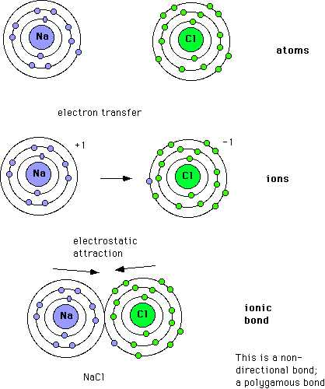
Ionic Bonds
Electron exchange creates a charge
Opposites charges attract
“salts”

Slide 28
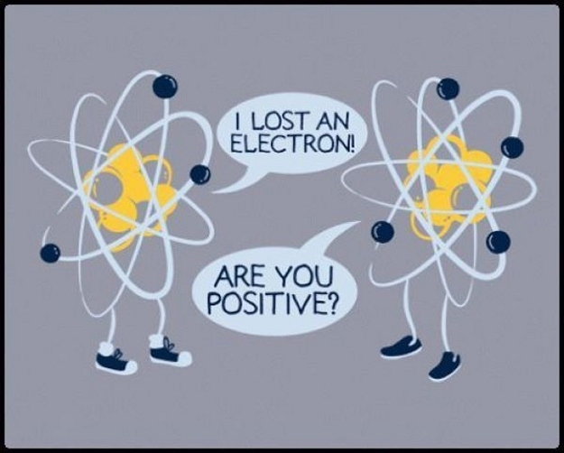
Chemistry Humor

Slide 29
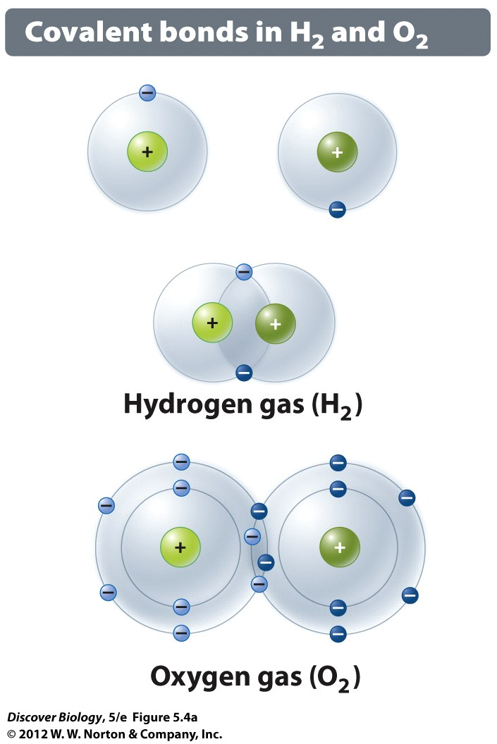
Covalent Bonds: Sharing Electrons
strong
“single”, “double” or “triple”
# of shared electrons
“molecules”

Slide 30
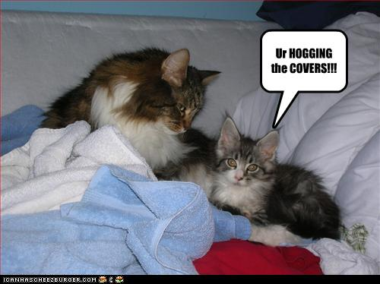
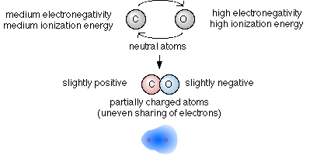
Polar Covalent Bonds
Charged
Negative end hogs electrons

Slide 31
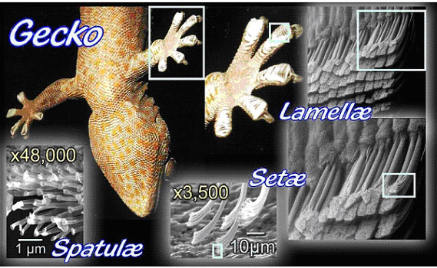
Weak Chemical Bonds
Van der Waals bonds – non-polar, temporary

Slide 32
Weak Chemical Bonds
Hydrogen bonds
hydrogen is NOT electronegative
Often positively charged
Opposite charges attract

Slide 33
Emergent Properties of Water
Cohesion
Temperature moderation
Insulation of water
Effective solvent

Slide 35
105° Bond
Angle lets water bond to many things

Slide 36
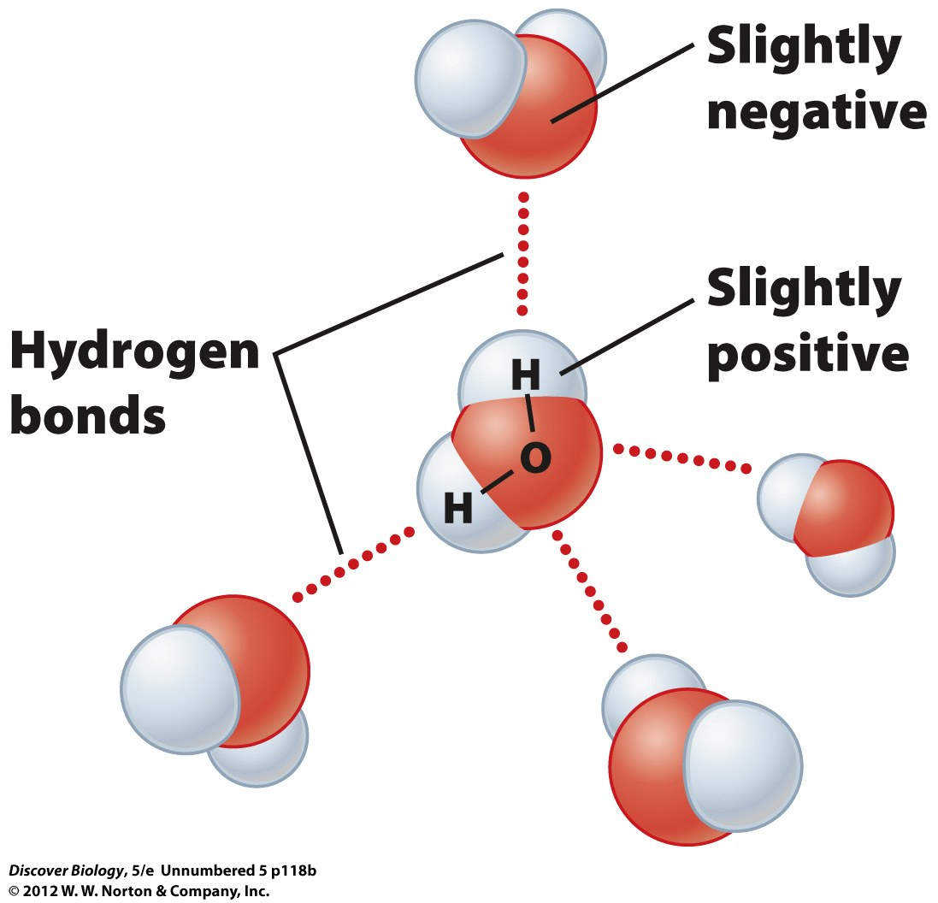
Molecular Shape and Function
The shape of a molecule is what allows it to do its job.
Oxygen attracts most of the electrons
(+) charge by hydrogens
(-) charge by oxygens

Slide 37
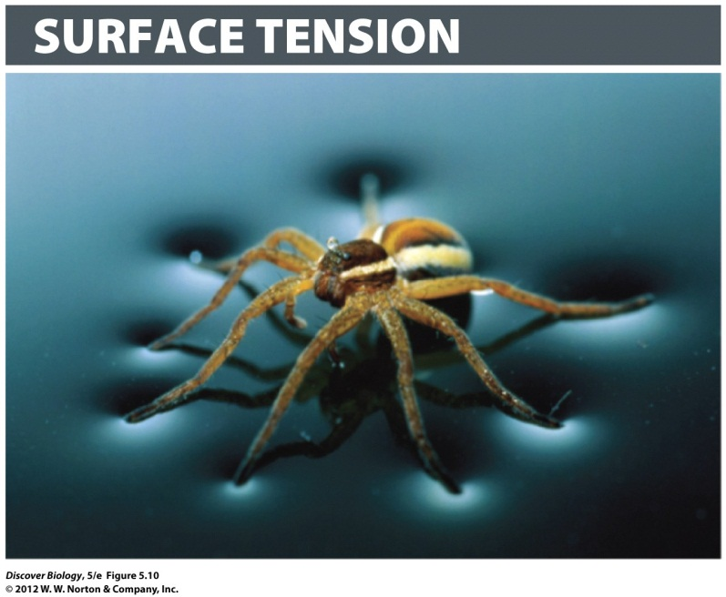
1. Cohesion/Adhesion of Water
Water molecules stick together due to hydrogen bonds (polar molecules)
Self = cohesion (e.g. surface tension)
Other = adhesion

Slide 38
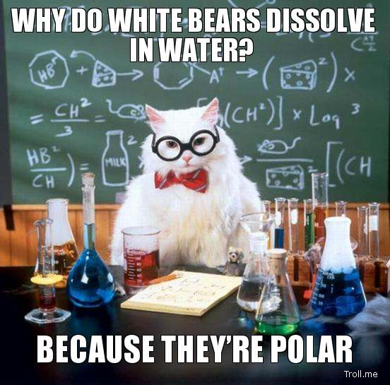
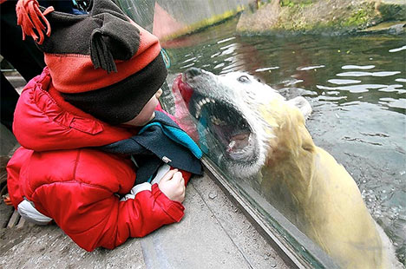
H₂0: Polar dissolves polar well
Why water is good at dissolving things

Slide 39
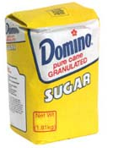
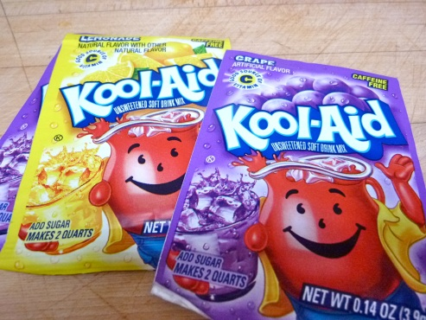
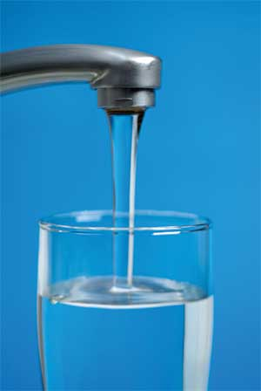
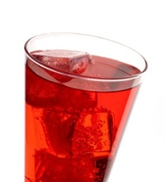
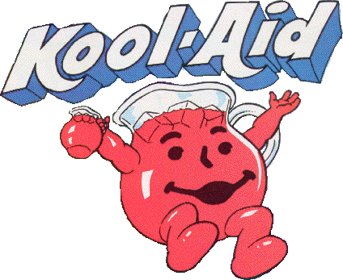
Solutions
Solute – stuff to dissolve
Solvent – substance to dissolve in
Solution = solute + solvent

Slide 40
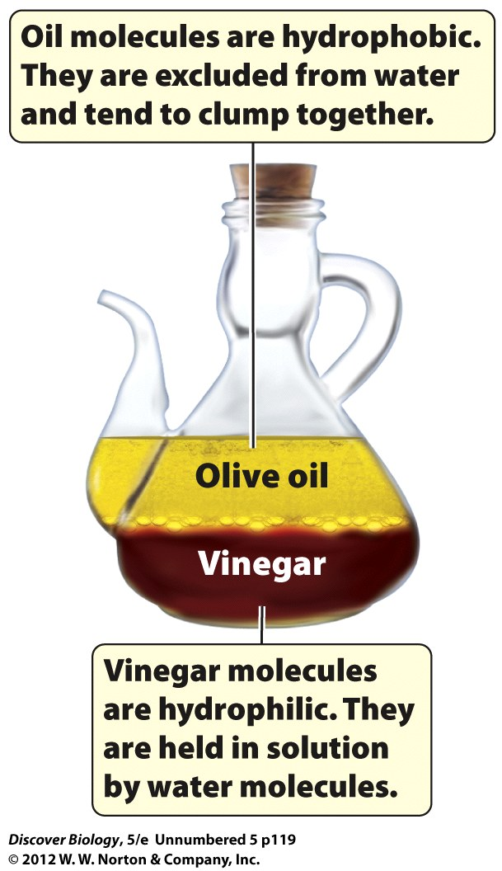
Water likes polar substances
Hydrophillic vs Hydrophobic
This is why membranes work

Slide 41
Temperature Moderation
High Specific Heat
kinetic energy
Heat vs. temperature
Celsius
Calories and kilocalories
Evaporative cooling

Slide 42
Ice Floats!!!
Solid that is less dense than the liquid
Insulates lake

Slide 43
Good Solvent
Solutions
Solution
Solvent
Solute
“aqueous”

Slide 44
Hydration Shells (Opposites Attract)
Solute
Solvent

Slide 45
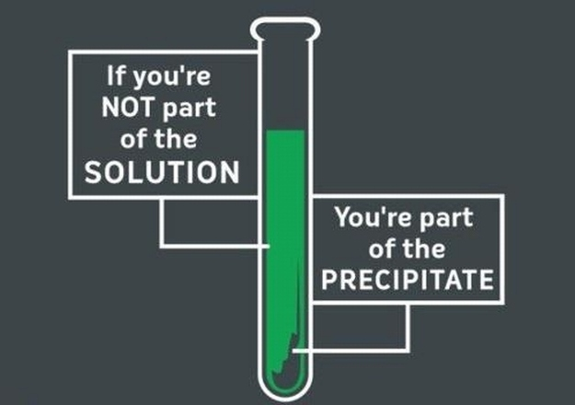
Bad Chemistry Joke

Slide 46
pH: How acid is it?
pH = -log[H+] DO NOT WRITE!!!!!
Lower numbers mean more hydrogen
(i.e. more acid)
Base – over 7
OH > H
High # = more basic
Neutral = 7
H⁺ = OH⁻
Acid – under 7
OH < H
Low # = more acidic

Slide 47
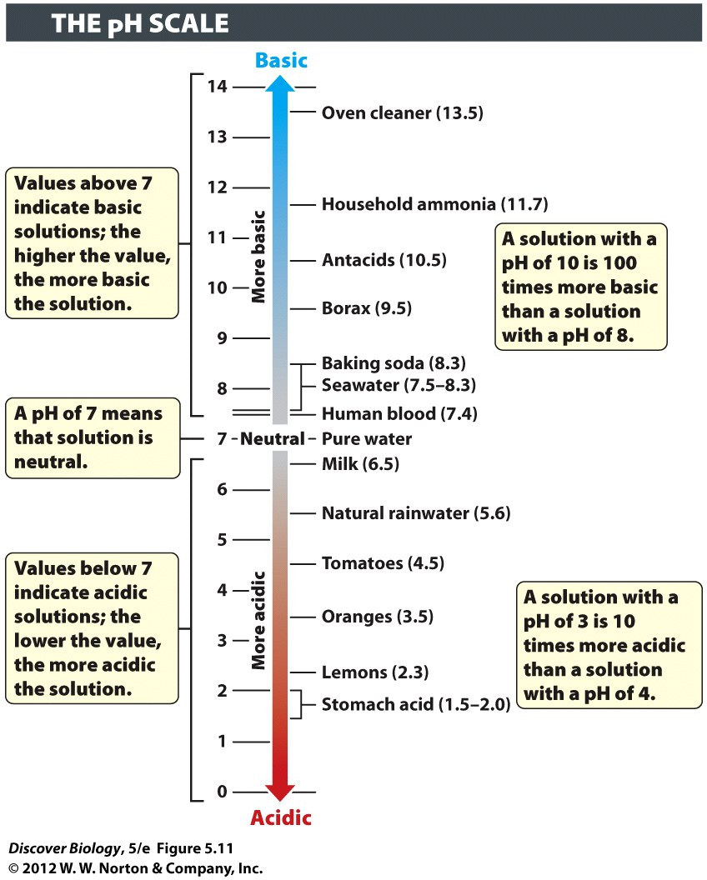
pH
Base – over 7
OH > H
High # = more basic
Neutral = 7
H⁺ = OH⁻
Acid – under 7
OH < H
Low # = more acidic

Slide 48
Buffer
Limits changes in pH
Keeps conditions from getting too acid or too basic

Slide 49
“Mono”
“Bi” or “Di”
“Tri”

Slide 50
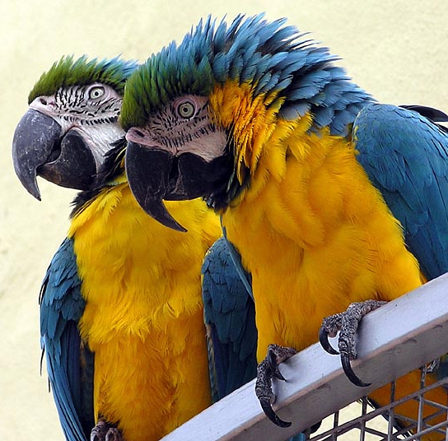
If there are more than three, we usually just say, “Poly”, which is a fancy way to say “there are many”

Slide 51
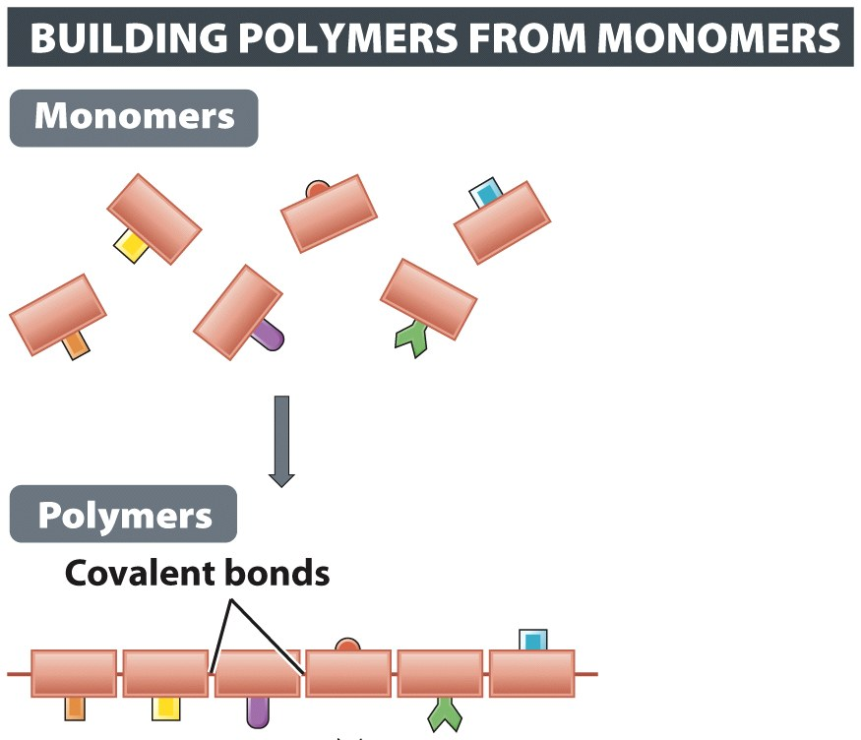
Polymers
One polymer is made from many monomers

Slide 52
Natural Polymers
Cellulose – structural material (cell walls)
Starch – used by plants for energy storage
Glycogen – used by animals for energy storage
Proteins – used by everything, for everything

Slide 53
Four Macromolecules
Carbohydrates – sugars, starches, cellulose
Proteins – structural, functional, enzymes
Lipids – Oils, fats, phospholipids, steroids
Nucleic acids – DNA and RNA

Slide 54
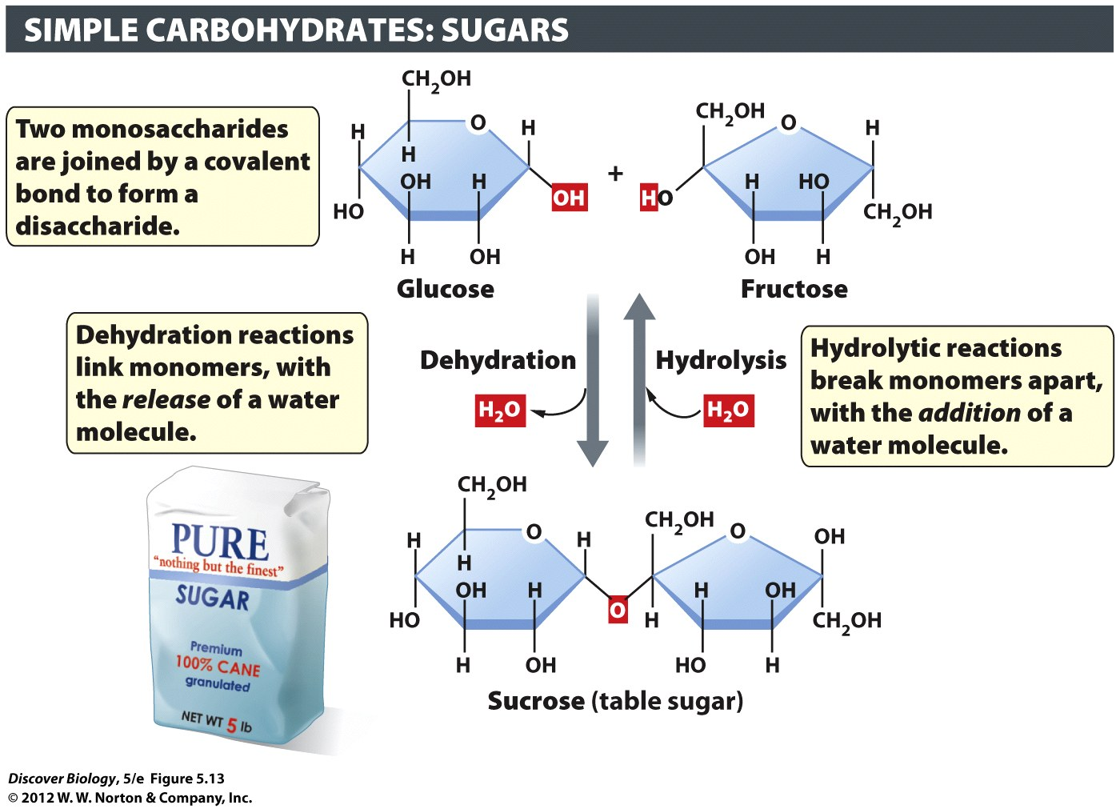
Dehydration
Synthesis

Slide 55
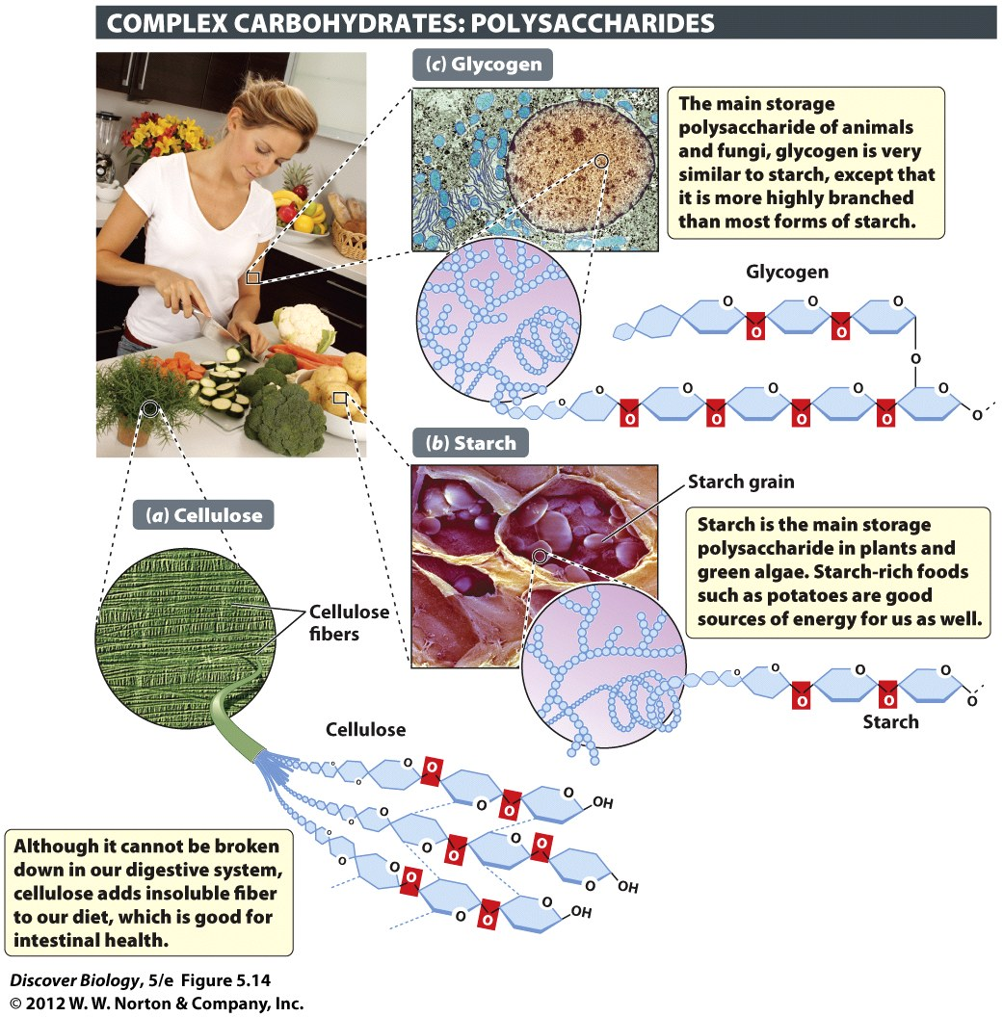
Polysaccharides
“Many” + “sugars”
Cellulose
Polymer of sugar
Walls of plant cells
Hard to digest
Starch
Polymer of sugar
Plant energy storage
Easy to digest

Slide 56
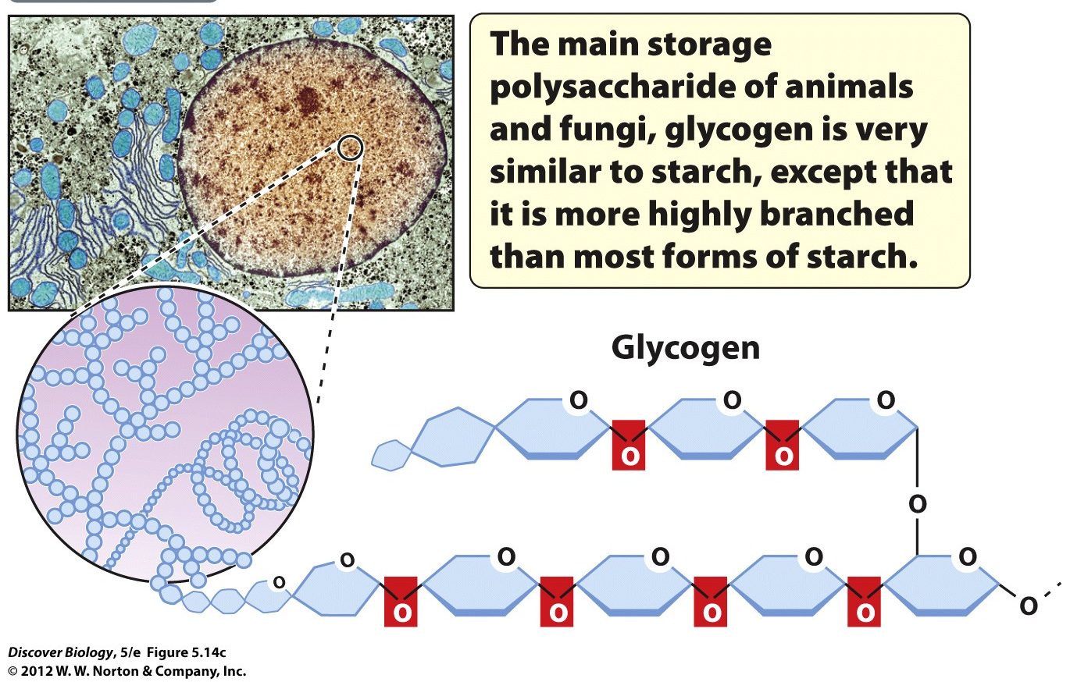
Glycogen
Energy storage in animals and fungi
Another polymer of sugars

Slide 57
Proteins: made of Amino Acids
Peptide bond – bond between amino acids
Monomer – amino acid
Polymer – polypeptide (“primary structure”) of protein

Slide 58
Proteins: Shape matters
Primary
Chain of amino acids
Secondary
Spirals and folds
Tertiary
3-D shape, 1 subunit
Quaternary
Several subunits (parts)

Slide 59
Protein: shape = function
How a protein is shaped controls what it can do
Change the shape = stop working
“denaturing” = changing from natural shape

Slide 60
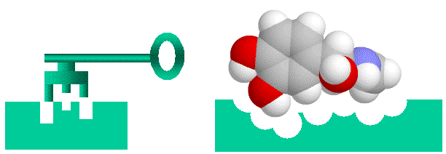
Enzymes: speed up a reaction
Make it easier for a reaction to happen
Not altered by reaction
Special shape to fit “substrate” chemical

Slide 61
Denaturing an enzyme
Changing the shape
Cannot do job anymore

Slide 62
Lipids
Fats, phospholipids, steroids
Mostly hydrogen and carbon
Fatty acid chains

Slide 63
Fatty acids
Long hydrocarbon chains
Saturated – filled with hydrogen
Unsaturated – less hydrogen

Slide 64
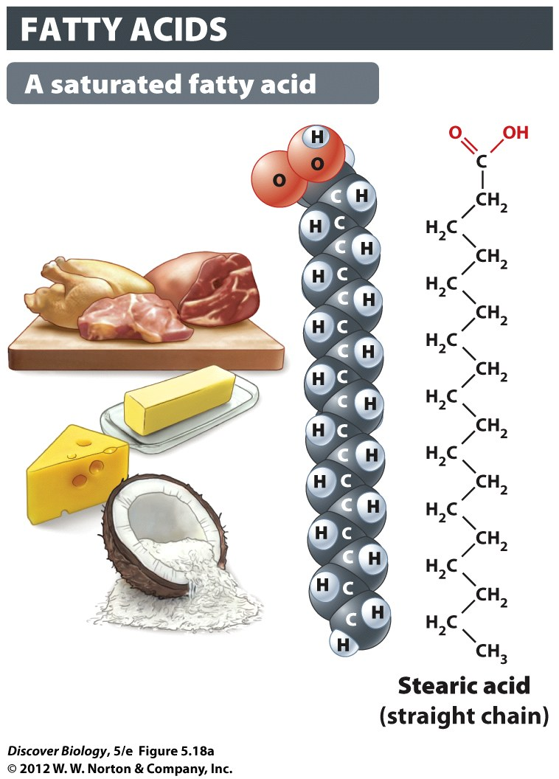
Fatty Acids:
Saturated (with H)
No double bonds
Molecules pack tightly

Slide 65
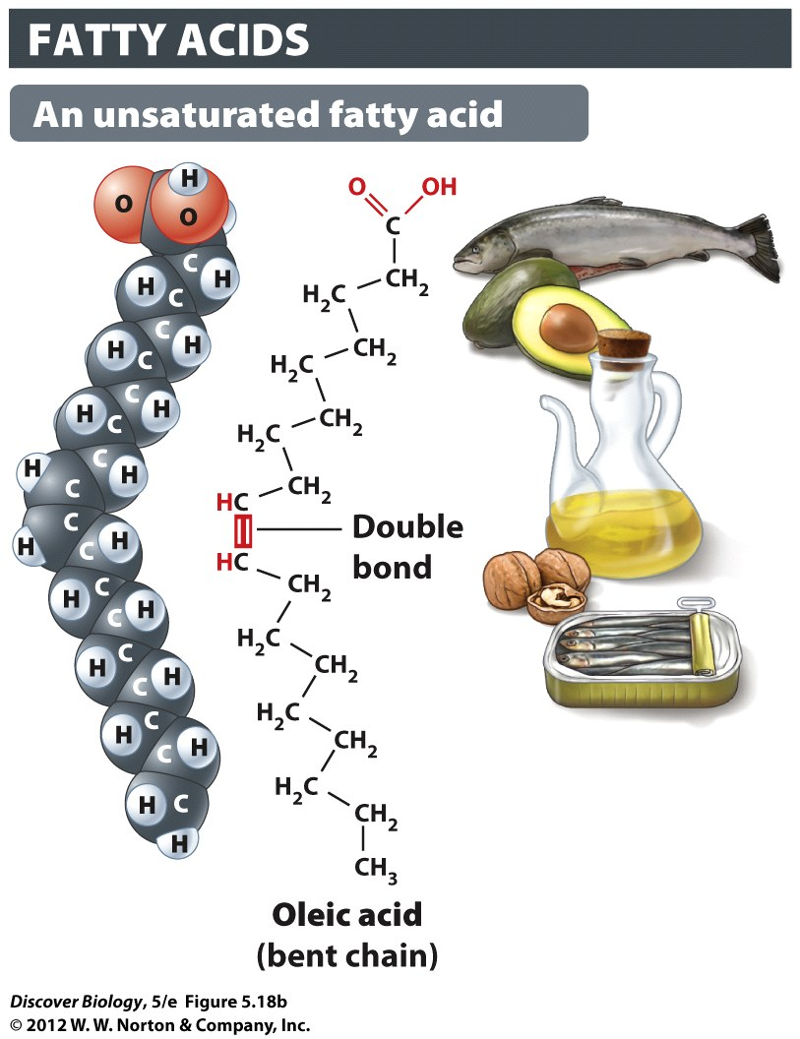
Fatty Acids:
Unsaturated
double bonds
Loosely packed
CIS ➔
TRANS ➔

Slide 66
Phospholipids
Main part of cell membrane
Hydrophilic head
Hydrophobic tails

Slide 67
Lipids: Sterols
Used to make Steroids and Cholesterol
We need some cholesterol to make membranes

Slide 68
Nucleic Acids
Instructions to make proteins
DNA stays in the nucleus
RNA made in nucleus, leaves through nuclear pores

Slide 69
Nucleic Acids
Polymers called “DNA” or “RNA”
Monomers are “nucleotides”
Three parts in nucleotide
Sugar
Phosphate
Nitrogenous base

Slide 70
Nucleic Acids
Backbone of strand: sugar-phosphate
RNA: sugar = Ribose
DNA sugar = Deoxyribose

Slide 71
Nucleic Acids: Bases
Backbone = sugar-phosphate
Bases = information

Slide 72
Free Biology Tutoring
Not Happy with your grade?
Not understanding the material?
Remember that the TLCC has

