Slide 1
Free Biology Tutoring
Not Happy with your grade?
Not understanding the material?
Remember that the TLCC has

Slide 2
Michèle Shuster, et. al: authors who think you don’t need to know about ATPsynthase
Biology for a
Changing World
SECOND EDITION
Lecture PowerPoint with the missing details restored to their rightful place
CHAPTER 6
Cellular Respiration
Copyright © 2014 by W. H. Freeman and Company

Slide 3
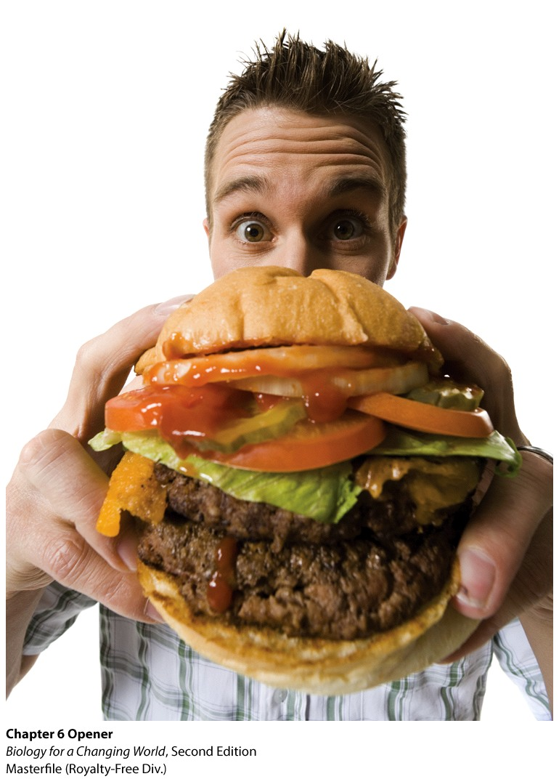
Chapter 6
Dietary Energy and
Cellular Respiration

Slide 4
Driving Questions
Why do humans weigh more than in the past?
How does the body use the energy in food?
How does aerobic respiration extract useful energy from food?
When does fermentation occur, and why can’t it sustain human life?

Slide 5
Food and Energy
Food is not only a source of nutrition; it is also a source of energy—the power to do work
calories (c)
the amount of energy required to raise the temperature of 1 g of water by 1°C
Food energy is measured in Calories (capital C)
equal to 1000 calories, or 1 kilocalorie (kcal)

Slide 6
Metabolism
Metabolism – reactions to use or release energy
2 kinds
Anabolism – Adds to molecules (makes them bigger)
needs energy
Catabolism – Cutting a big molecule apart
releases energy

Slide 7
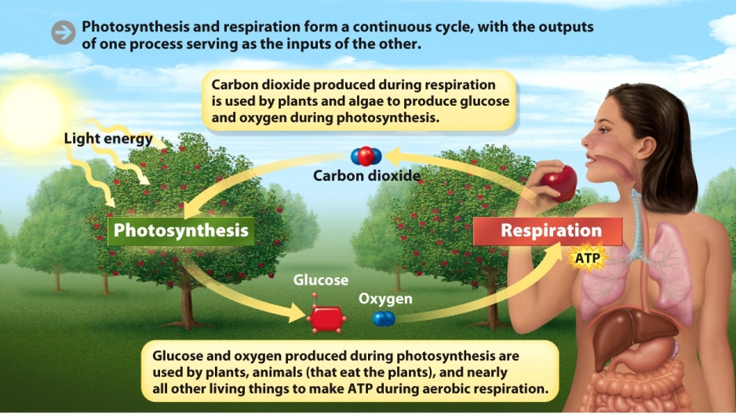
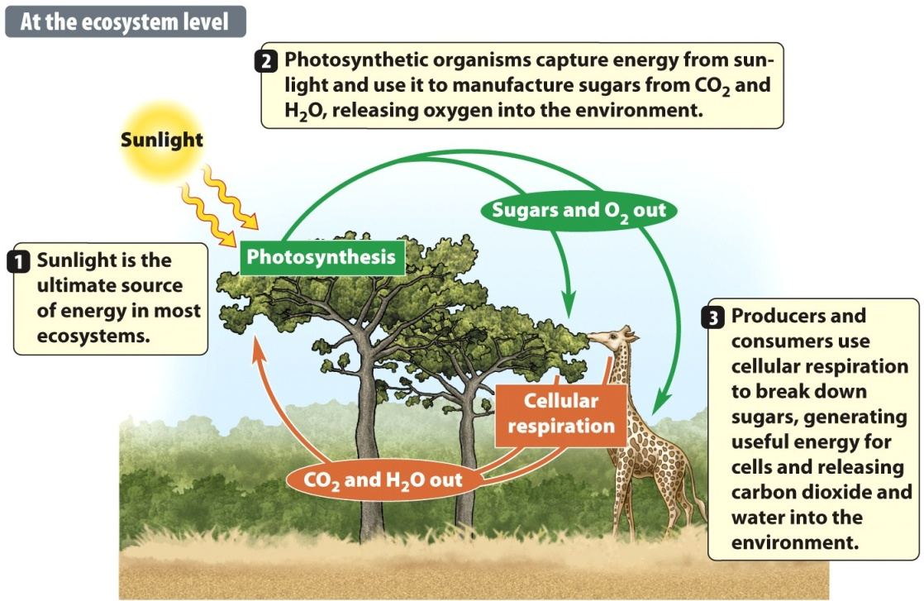
Notes:
Figure 8.4 Anabolic Reactions Build Macromolecules, Catabolic Reactions Degrade Them

Slide 8
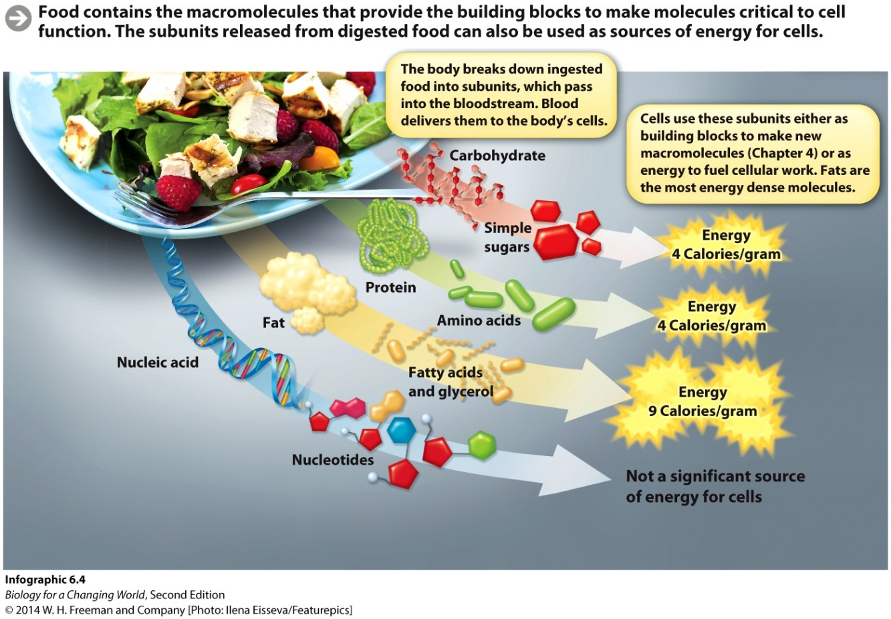
Food is a source of energy
Food contains macromolecules
Broken down into building blocks or subunits
Used to make new molecules and as sources of energy
Notes:
Food is a source of chemical energy.

Slide 9
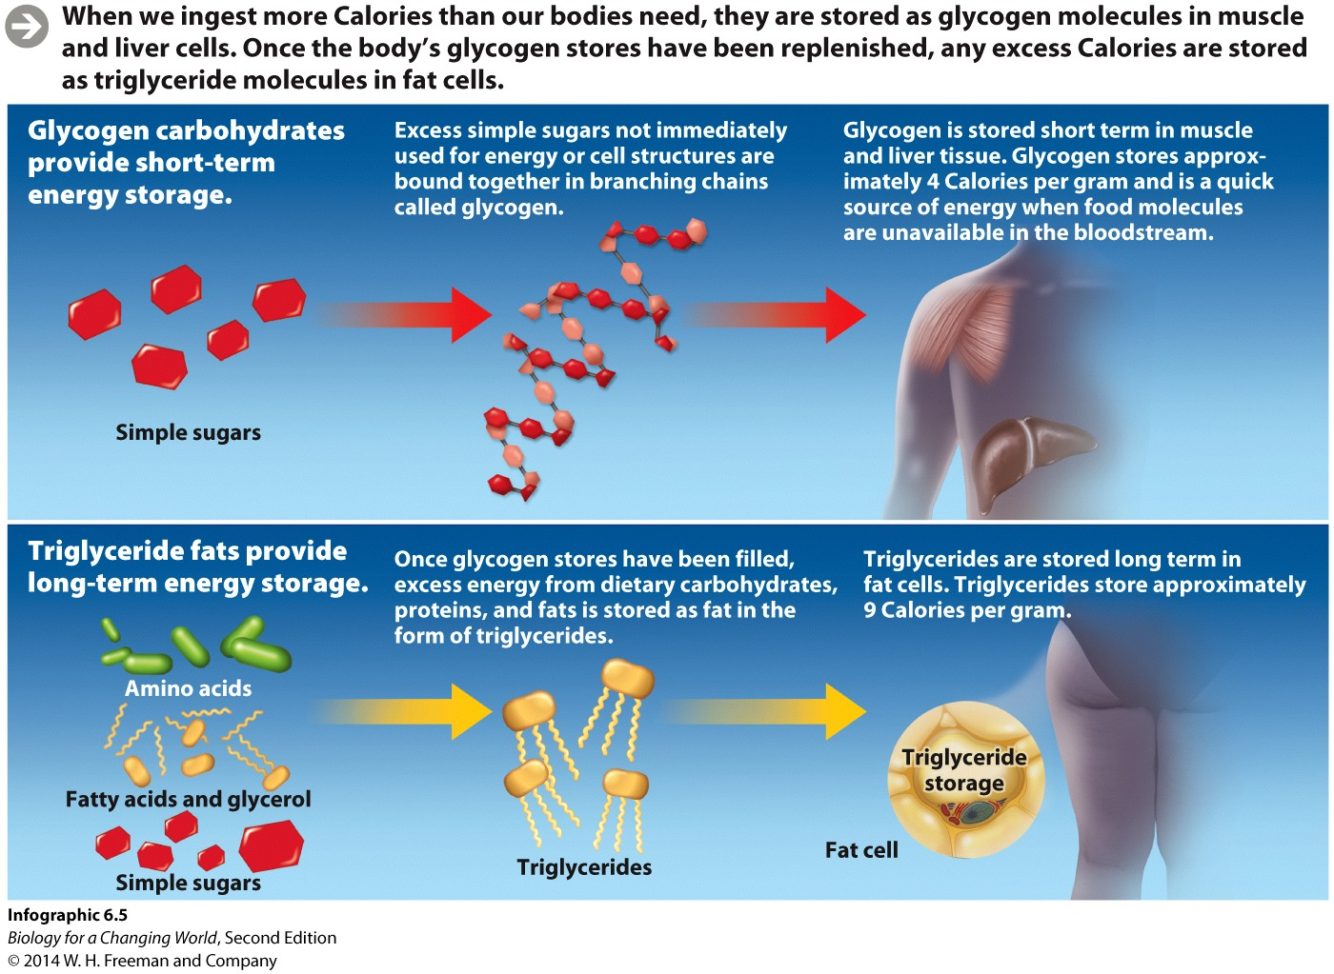
Storing excess Calories
Glycogen is a complex animal carbohydrate, made up of linked chains of glucose molecules. Glycogen is used in our body as short-term energy storage. (carb loading)
Notes:
When we ingest more Calories than our bodies need, they are stored as glycogen molecules in muscle and liver cells. Once the body’s
glycogen stores have been replenished, any excess Calories are stored as triglyceride molecules in fat cells.

Slide 10
Storing excess Calories
Triglycerides are a type of lipid found in fat cells that are used for long-term energy storage
Notes:
Once glycogen stores are refilled, excess Calories are stored as triglyceride molecules in fat cells.

Slide 11
Burning excess Calories
The body burns fat only after it has used up food molecules in the bloodstream and in stored glycogen

Slide 12
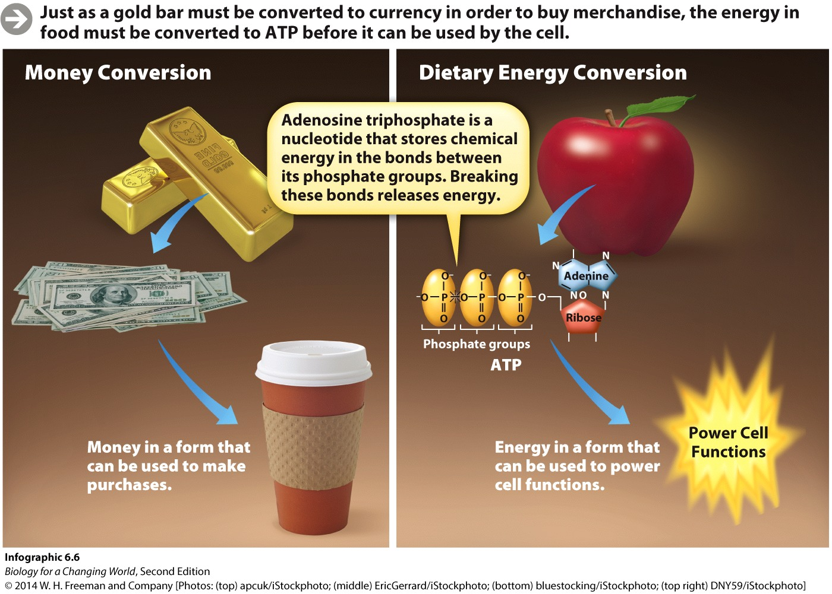
Extracting energy from food
Energy from food is ultimately captured in the molecule adenosine triphosphate (ATP)
This is the main fuel of the cell
Notes:
Food must be broken down into its component subunits—among them, fats and sugars. Then, these breakdown products must go through a series of biochemical reactions that convert the chemical energy stored into a form of fuel we can use.
Energy from food is ultimately captured in a molecule called adenosine tri- phosphate (ATP) that our cells use to carry out energy-requiring functions.

Slide 13
How do cells use ATP
ATP chemical bonds are broken, energy is released, allowing the cells to do work

Slide 14
Extracting energy from food
Inside the cells, enzymes break the bonds holding the subunits together
The energy released is captured and converted into molecular bonds that make up ATP

Slide 15
Cellular Respiration: Energy from Food
Both producers and consumers do Cellular Respiration (plants have mitochondria, too!!)
Three main stages of cellular respiration:
Glycolysis
The Krebs cycle
Oxidative phosphorylation
(electron transport chain)

Slide 16
Extracting energy from food
Aerobic respiration
a series of reactions that converts stored food energy into ATP
occurs in presence of oxygen
Notes:
Aerobic respiration transfers food energy to ATP.
During aerobic respiration, our cells use the oxygen we inhale to help extract energy from food. Cells convert the energy stored in food molecules into the bonds of ATP, the cell’s energy currency.

Slide 17
Aerobic Respiration
Glucose is the most common source of energy for all organisms
Aerobic respiration of glucose is summarized as
Glucose + Oxygen → Carbon Dioxide + Water + Energy (+ Heat)
You need to be able to list the inputs and outputs

Slide 18
Extracting energy from food
Notes:
Aerobic respiration: cells use the oxygen we inhale to help extract the energy from food, bonds of glucose are broken, the energy released is used to form ATP and heat. Water and carbon dioxide are given off as waste products.

Slide 19
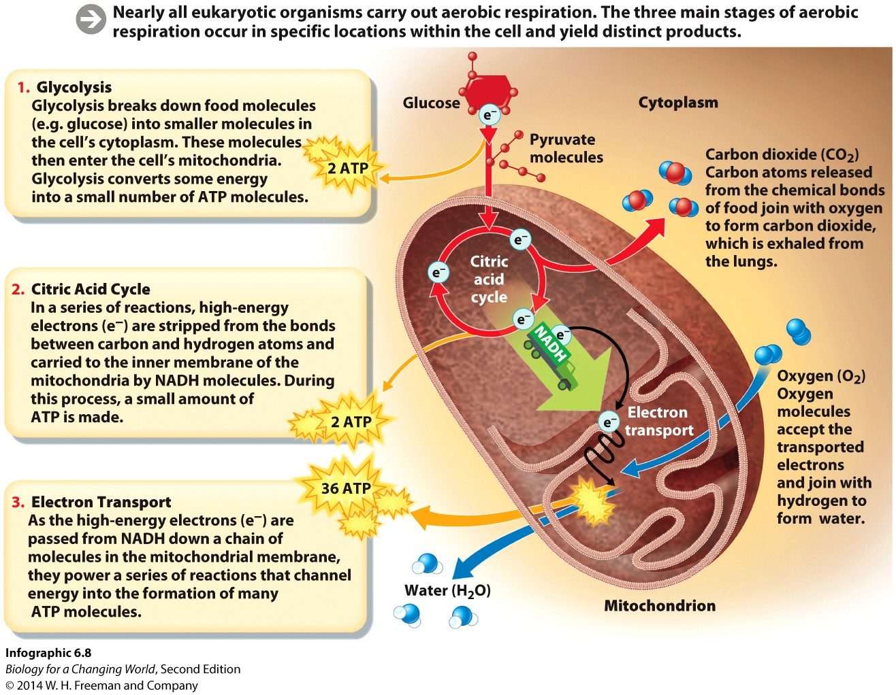
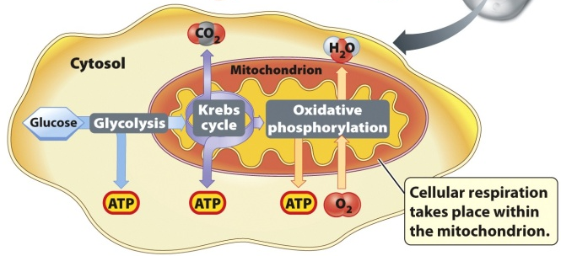
Aerobic respiration: 3 Stages
“Uses oxygen”
In cytosol, no O2➔
“Krebs Cycle”
In mitochondria, needs O2➔
In mitochondria, needs O2➔
_______
Why?
There are two ETCs
in photosynthesis
“oxidative phosphorylation”

Slide 20
Glycolysis: Part 1
1st stage of cellular metabolism
“Glyco”(glucose) + “lyse”(break) = breaking glucose
Happens in cytosol
Outside Mitochondria
6-carbon glucose ➔ 3-carbon pyruvate

Slide 21
Glycolysis: Stage 1 of cellular resp.
“Glyco”(glucose) + “lyse”(break) = breaking glucose
happens in the cytosol (outside mitochondria)
No oxygen
Notes:
Glycolysis is a series of chemical reactions that splits glucose in half, into two smaller molecules of pyruvate. Each of these pyruvate molecules has three carbon atoms in its backbone.

Slide 22
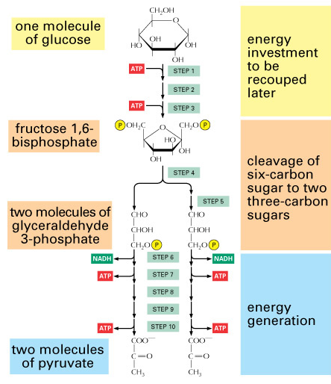
Glycolysis: Stage 1 of cellular resp.
Uses 2 ATP
Makes 4 ATP (NET GAIN=2)
One 6-carbon glucose is broken into two 3-carbon pyruvate
Pyruvate then enters the mitochondria for steps two and three, during which it is broken down
Notes:
Glycolysis is a series of chemical reactions that splits glucose in half, into two smaller molecules of pyruvate. Each of these pyruvate molecules has three carbon atoms in its backbone.

Slide 23
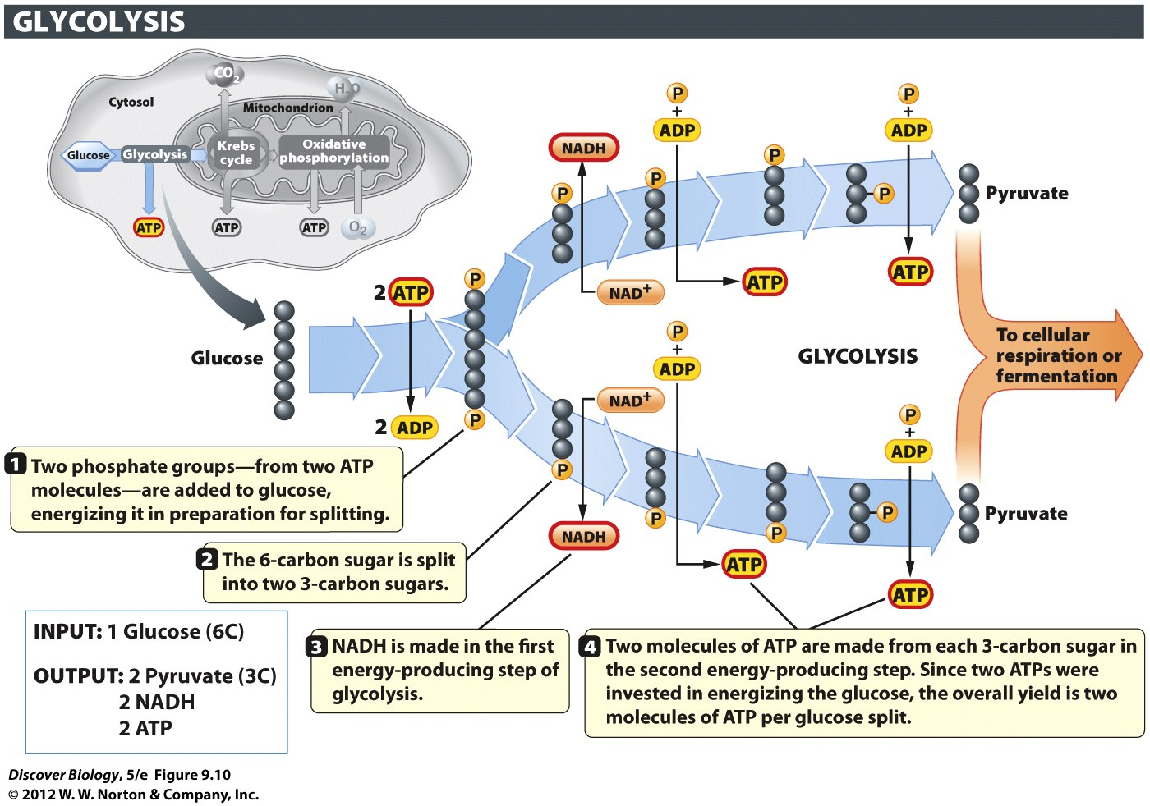
Notes:
Figure 9.10 Glycolysis Converts Glucose into Pyruvate
In glycolysis, each six-carbon glucose is converted into two molecules of pyruvate, a three-carbon organic acid.

Slide 24
We need LOTS of ATP
Glycolysis
No O2 used
doesn’t make enough ATP (<1/4 total)
exception: some bacteria and fungi (yeast)
Two more steps in Cellular Respiration
Kreb Cycle – Needs O2
“Oxidative phosphorylation” – needs O2
Most ATP made here

Slide 25
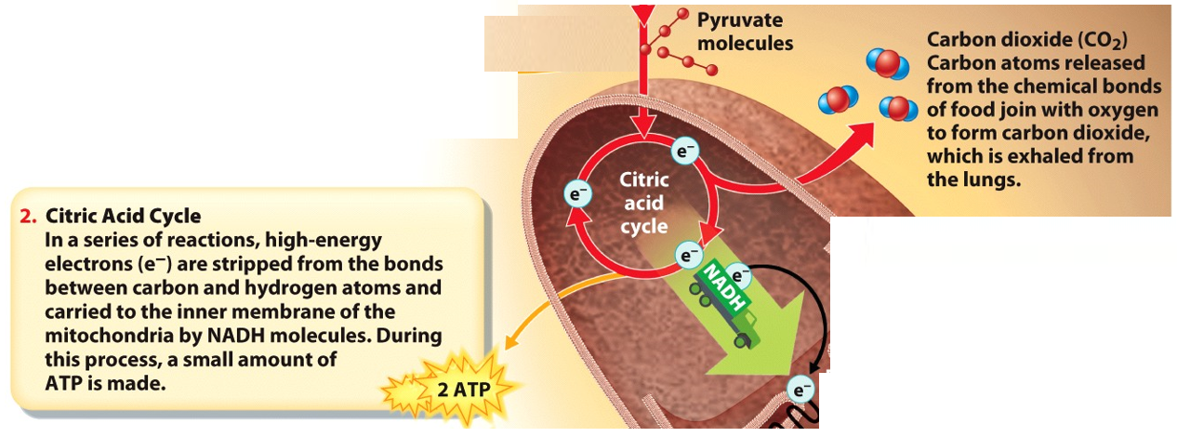
Krebs Cycle: Stage 2 of Cellular Metabolism
“aerobic” – uses oxygen
Happens in mitochondria
Lots of mitochondria in muscle
Lots of energy for muscle
Requires lots of blood flow (oxygen for mitochondria)

Slide 26
Krebs Cycle: Cellular Metabolism (part2)
Pyruvate into mitochondria
output (product) from glycolysis
will be used as input (reactant) for Krebs
must be modified first!!!
Pyruvate ➔ acetyl CoA (requires oxygen)
Krebs (a.k.a. “Citric Acid Cycle”) makes ENERGY
a little ATP
a LOT of NADH
a little FADH₂,

Slide 27
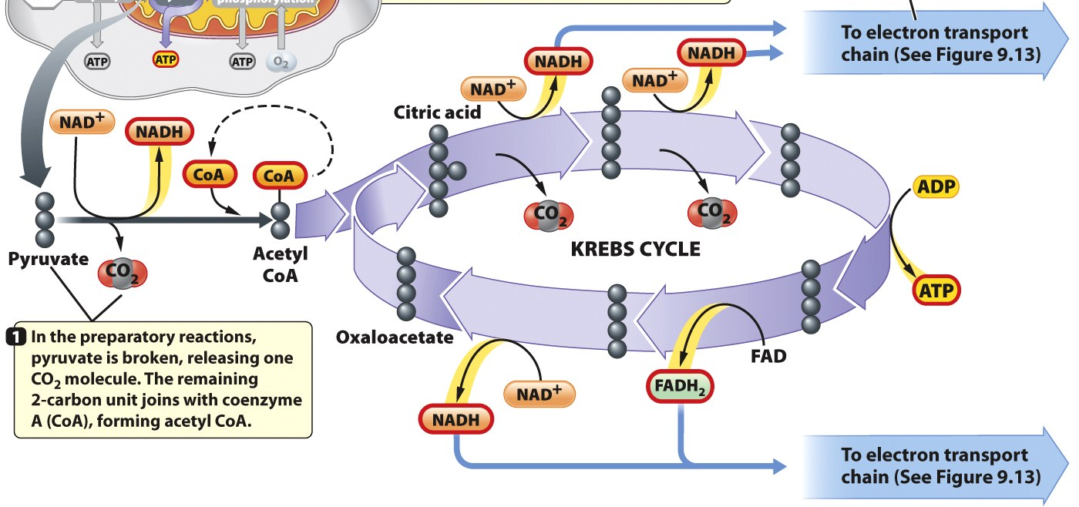
Krebs Cycle: Cellular Metabolism (part2)
Pyruvate ➔ acetyl CoA (requires oxygen)
Krebs (a.k.a. “Citric Acid Cycle”) makes ENERGY
a little ATP, LOTS of NADH, a little FADH₂,
_{uses O2}
_{uses O2}
_{uses O2}
Why the Krebs Cycle needs oxygen

Slide 28
About those NADHs
NAD+ picks up electrons and hydrogen released from catabolic reactions
Why: So we can use them later & make more ATP

Slide 29
Krebs Cycle: Cellular Metabolism (part2)
Krebs Releases Carbon Dioxide (why we exhale CO2)
Oxygen needed to start pyruvate➔AcetylCoA
Break carbon chains apart
capture hydrogens and high energy electrons
use them later to power production of
energy molecules from Krebs: , NADH, FADH2
Why NADH & FADH2?
(NEVER WASTE ENERGY)

Slide 30
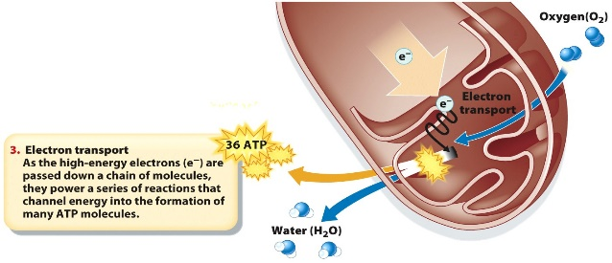
O.P.: Cellular Metabolism (part 3)
“Oxidative Phosphorylation”
Requires Oxygen
“use oxygen to add phosphate”
Happens in mitochondria
WHERE MOST ATP COMES FROM!!!!

Slide 31
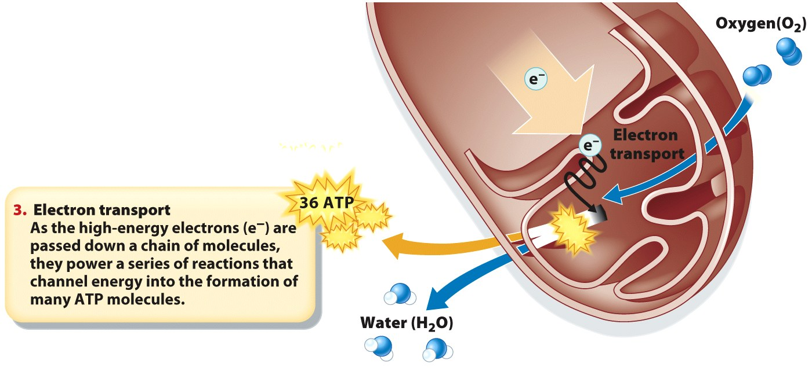
Oxidative Phosphorylation: a closer look
last step of aerobic respiration, makes most of ATP
Electrons from glycolysis & krebs ➔ inner membranes of mitochondria
Electrons loose energy, passed down a chain of molecules to oxygen
Oxygen accepts the electrons and combines with hydrogen atoms to produce water
Produces most of the ATP

Slide 32
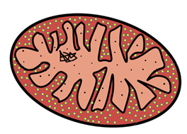
It’s all about the oxygens
Oxygen is electronegative
Wants
Wants to become negative
receptor at end of chain
Why OXIDATIVE phosphorylation
needs OXYGEN

Slide 33
Oxidative Phosphorylation .
Oxidative phosphorylation most of ATP
3rd (last) stage of cellular respiration
Happens in folds (cristae) of mitochondria
Inner membrane (no folds in outer)

Slide 34
O.P.: Cellular Metabolism (part 3)
Uses Oxygen to Produce ATP in Quantity
NADH & FADH2 from Krebs: electron source
Electron Transport Chain (ETC)
Gets energy from the electrons
uses energy to pump protons
active transport (like subway)

Slide 35
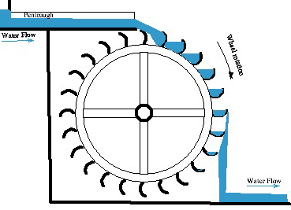
O.P.: Cellular Metabolism (part 3)
Protons move from high ➔ low concentration
Moving protons = energy
Moving protons turn ATPsynthase (enzyme)
ATPsynthase synthesizes ATP

Slide 36
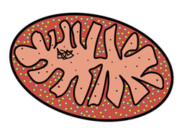
O.P.: Cellular Metabolism (part 3)
Electrons from ETC are to O₂
Electrons + O₂ + H⁺ ➔ water (H2O)
ATPsynthase is ALWAYS powered by hydrogen ions

Slide 37
Cellular Respiration: Total ATP yield
Cellular respiration has three steps
Glycolysis – no oxygen needed
Krebs Cycle – Needs Oxygen
Oxidative Phosphorylation – Needs Oxygen
Cellular respiration = 30 to 32 ATP / glucose

Slide 38
Cells can also also burn other molecules for fuel
Fats and amino acids are also fuel for aerobic respiration
Fats have more electrons and therefore produce more ATP

Slide 39
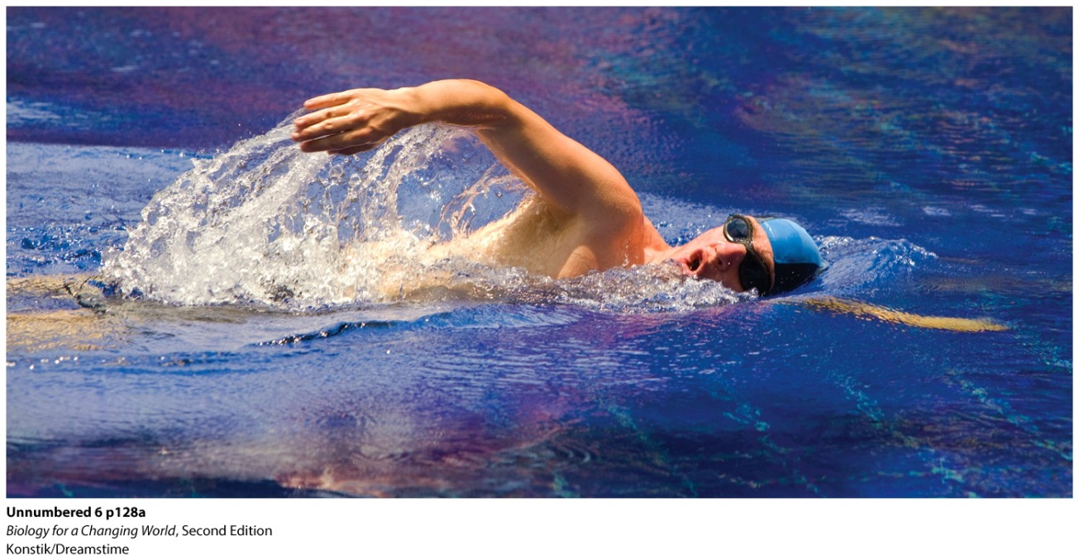
When oxygen is scarce
Sometimes oxygen consumption exceeds oxygen intake
Electron transport chain needs oxygen to receive electrons

Slide 40
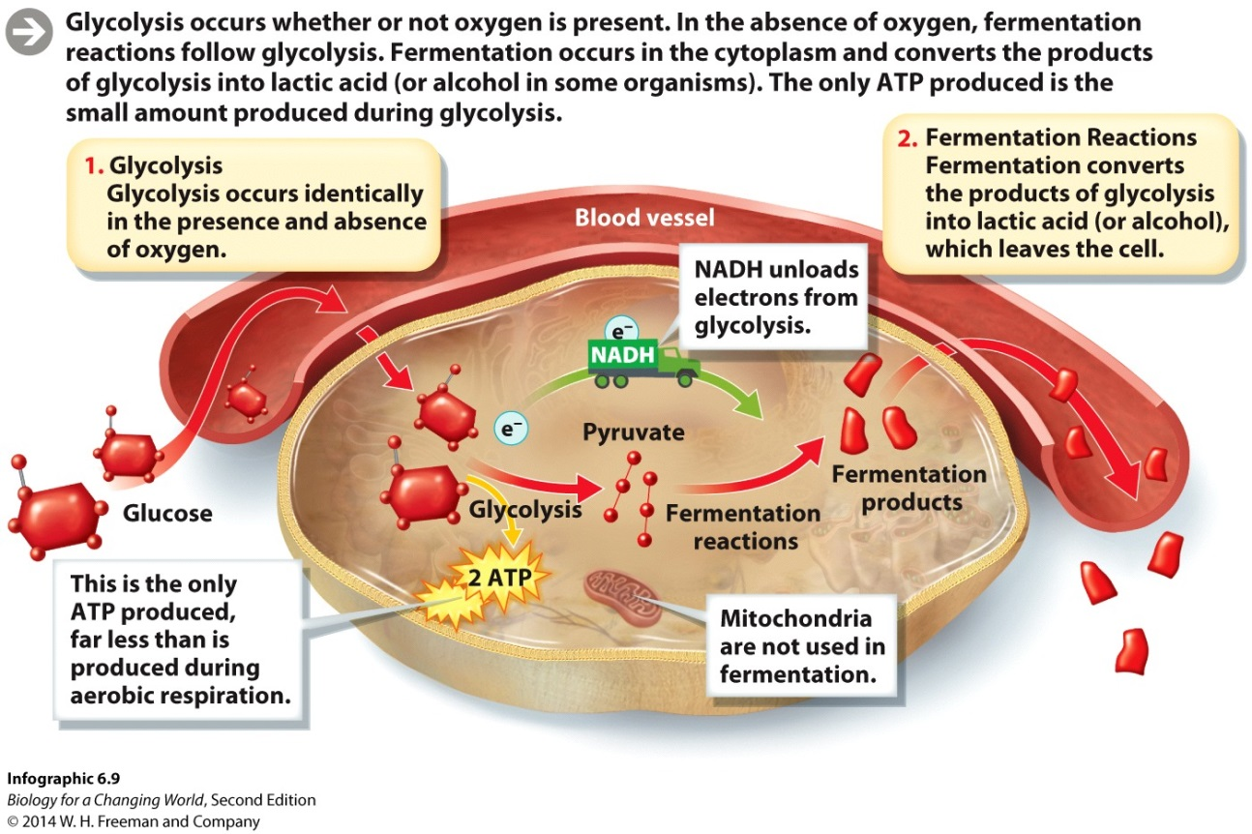
Fermentation
Glycolysis occurs in the absence of oxygen
Products now undergo fermentation
Occurs in cytoplasm
Makes lactic acid or alcohol

Slide 41
Anaerobic respiration: Problem
Only do Glycolysis - No oxygen needed
Glycolysis requires NAD+
No NAD+ = no glycolysis
Glycolysis stops if we can
not turn NADH back into
NAD+

Slide 42
Anaerobic respiration: Solution
Turn pyruvate from glycolysis into something else (requires energy and hydrogen)
NADH ➔ NAD+
Now we can still do glycolysis
Pyruvate turned into alcohol or lactic acid

Slide 43
Fermentation Facilitates ATP Production Through Glycolysis When Oxygen Is Absent
Fermentation by anaerobic yeasts converts pyruvate into an ethanol, releasing CO2 gas
Lactic acids forms in severely taxed muscle cells as a result of ATP production in the absence of oxygen

Slide 44
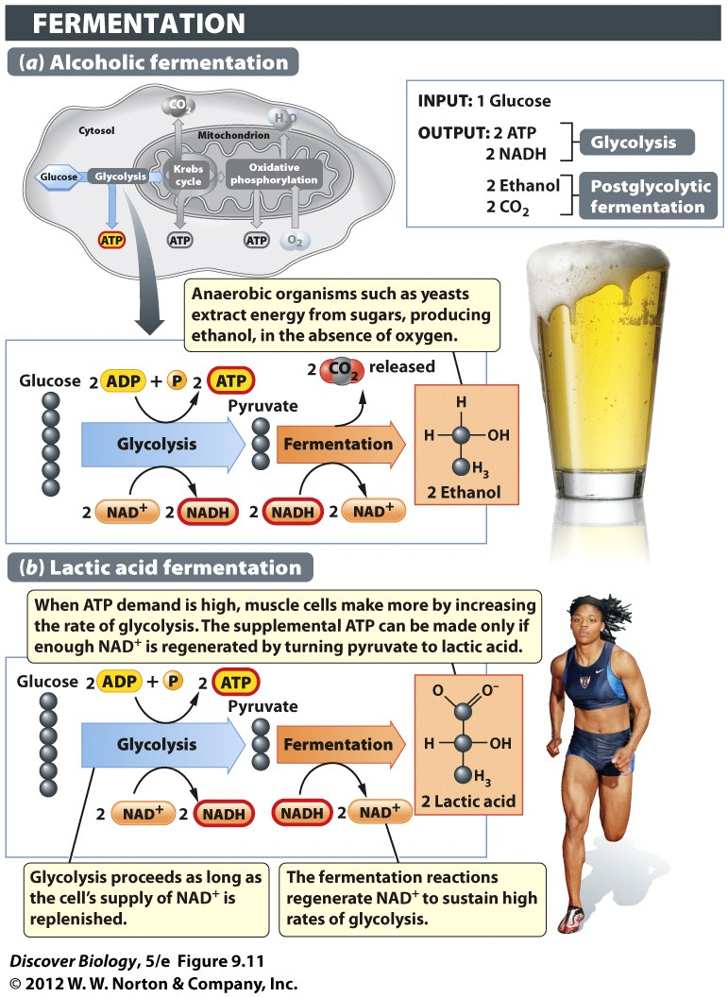
Notes:
Figure 9.11 Ethanol and Lactic Acid Are By-products of Fermentation
When the oxygen supply is inadequate for supporting ATP production through cellular respiration, fermentation supports ATP production through glycolysis alone. (a) Strains of yeasts, which are single-celled fungi, are used in the brewing of alcoholic beverages such as beer. When oxygen is excluded from the fermentation tanks, the yeasts resort to fermentation of sugars, producing ethanol and CO₂ as by-products of the postglycolytic steps. (b) A similar process occurs in our muscles during short bursts of strenuous exercise, except that the postglycolytic reactions turn pyruvate into a three-carbon organic acid known as lactic acid, and no CO₂ is made.

Slide 45
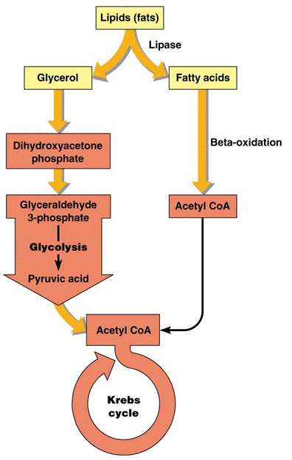
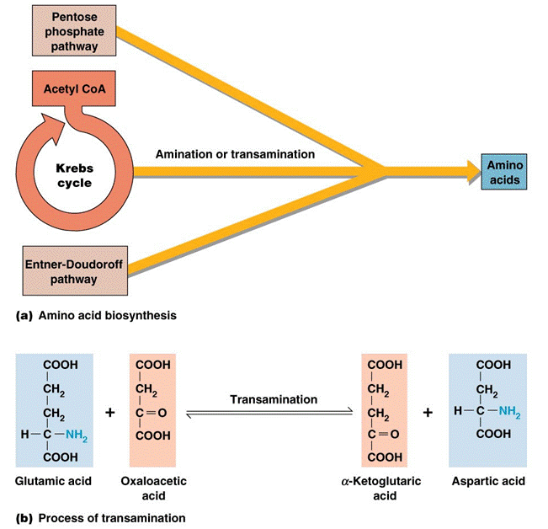
The Truth: metabolism is more than just breaking carbs
proteins
lipids
There’s more than one way to do cell respiration!!!

Slide 46
Summary
The macronutrients in our food (proteins, carbohydrates, and fats) are sources of dietary energy.
Cells carry out chemical reactions that break down food to obtain usable energy in the form of ATP.
Photosynthesis and respiration form a cycle: the carbon dioxide given off during aerobic respiration is used by photosynthesizers to make glucose and oxygen.
Exercise helps burn stored Calories.
During exercise, glycogen is used first. Stored fats are tapped only when glycogen stores have been depleted.

Slide 47
Clicker Questions
CHAPTER 9
Photosynthesis and
Cellular Respiration

Slide 48
Concept Quiz
A common feature of both chloroplasts and mitochondria is
A. The use of chlorophyll
B. Production of CO₂
C. Use of an electron transport chain
D. Presence in all cells
Notes:
The correct answer is C. The commonality of the ETC was stressed in the lecture and is important to the function of both organelles
Answer A is incorrect because only chloroplasts use chlorophyll.
Answer B is incorrect because mitochondria produce CO₂, while chloroplasts use it.
Answer D is incorrect, because mitochondria are used in all cells, but chloroplasts are only in the photosynthesizing cells of plants.
This question can be expanded in an in-class discussion of other similarities between these two organelles.
Some other similarities include: production of an H+ gradient, production of ATP, use of energy transfer molecules (NADPH or NADH), double membrane structure, and the presence of a chromosome.

Slide 49
Concept Quiz
Most of the ATP produced by aerobic respiration comes from
A. Glycolysis
B. The citric acid cycle
C. Oxidative phosphorylation
D. Fermentation
Notes:
The correct answer is A. Although some ATP is made directly in glycolysis and the citric acid cycle, most of the ATP is made when the electrons from NADH are used by the ETC in Oxidative Phosphorylation. This should be stressed because this is why aerobic respiration is so much more efficient than anaerobic.
Answers B & C: As mentioned above, some ATP is made directly, but most is made by ATP synthase.
Answer D: Fermentation is not part of aerobic respiration and produces very little energy.

Slide 50
Log into PAL
Have you taken the latest quiz?
When is your next paper due?
If you are not sure, you need to

