Slide 1
Free Biology Tutoring
Not Happy with your grade?
Not understanding the material?
Remember that the TLCC has

Slide 2
Michèle Shuster • Janet Vigna • Gunjan Sinha • Matthew Tontonoz
Biology for a
Changing World
SECOND EDITION
Lecture PowerPoint
CHAPTER 4
Nutrition, Metabolism, Enzymes
Copyright © 2014 by W. H. Freeman and Company

Slide 3
Driving Questions
What are enzymes, and how do they work?
What are the macronutrients and micronutrients provided by food?
What are essential nutrients?
What are the consequences of a diet lacking sufficient nutrients?

Slide 4
Energy: the ability to do work
Work – cause change in a system
Types of Energy
Potential energy – energy based on position
Water behind dam (position of water)
Chemical energy (position of atoms)
Kinetic Energy – energy of motion
Waterfall – can turn waterwheel

Slide 5
Energy: Kinetic Energy
Kinetic energy includes:
Mechanical energy
Light energy
Electrical energy
Heat energy
Heat = random motion of particles
Motion energy can by transferred to other particles

Slide 6
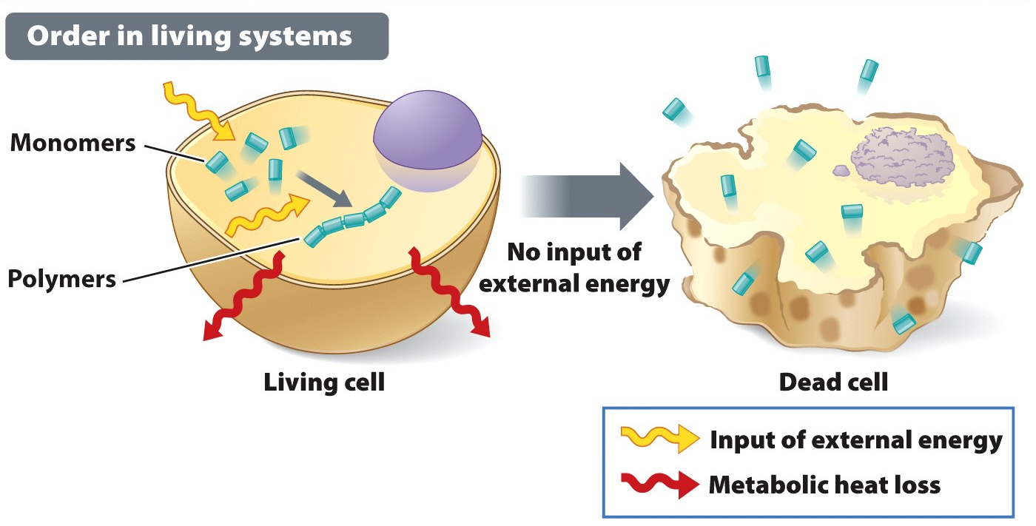
Cells need energy to survive

Slide 7
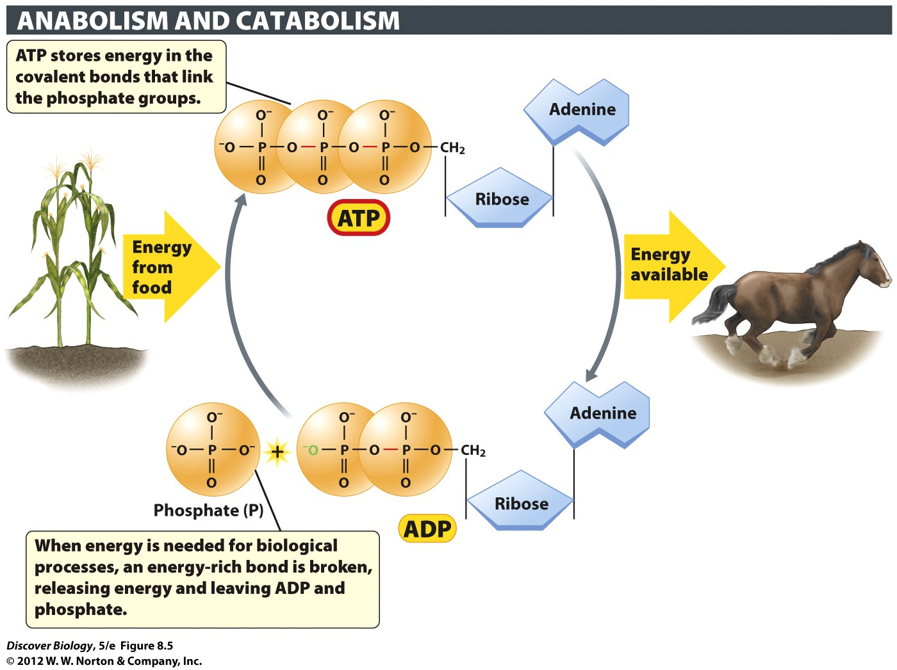
Notes:
Figure 8.5 ATP Functions as an Energy-Storing Molecule in All Cells
When the terminal high-energy bond of ATP breaks, energy is released, and ATP is turned into ADP (adenosine diphosphate) with the release of a phosphate group.

Slide 8
Chemical Reactions: Terms
Products – produced by a reaction
Output of a reaction
Reactants – input to a reaction
will be used in a reaction

Slide 9
Chemical Reactions
activation energy - energy needed to start a reaction
Catalysts lower reaction’s activation energy
Easier for reaction to occur
Not part of reaction!!!
Enzyme – a catalyst made of protein

Slide 10
Metabolism: enzymes
Enzyme: protein that speeds up a chemical reaction
Substrate: molecule to which an enzyme binds and on which it acts
Active site: part of an enzyme that binds to the substrate

Slide 11
Metabolic Pathways: Making & Breaking macromolecules
Some pathways make macromolecules
Photosynthesis – G3P
chemosynthesis
Some pathways break down macromolecules
Cellular Respiration
“Anabolic”
“Catabolic”

Slide 12
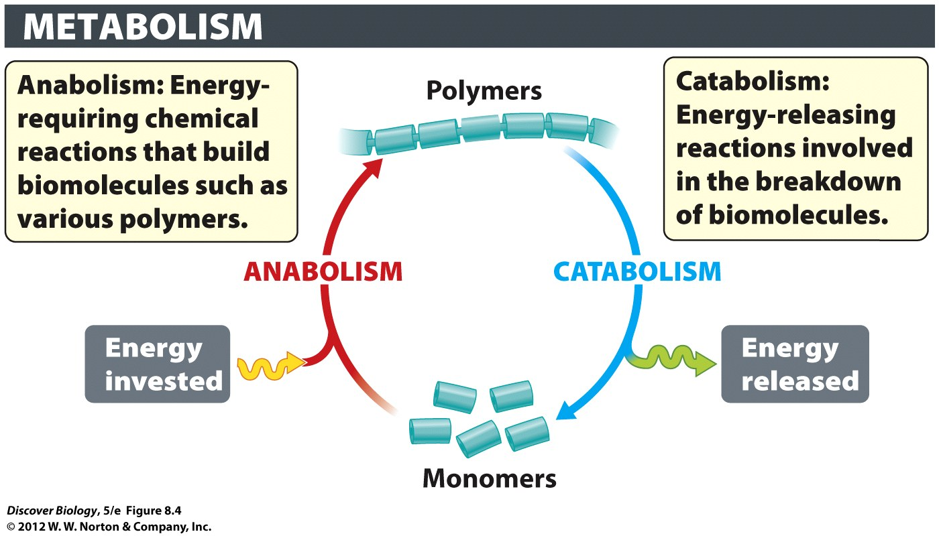
Metabolism
Metabolism – reactions to use or release energy
2 kinds
Catabolism – Cutting a big molecule apart
releases energy
Anabolism – Adds to molecules (makes them bigger)
needs energy
BOTH USE CHAINS OF ENZYMES

Slide 13
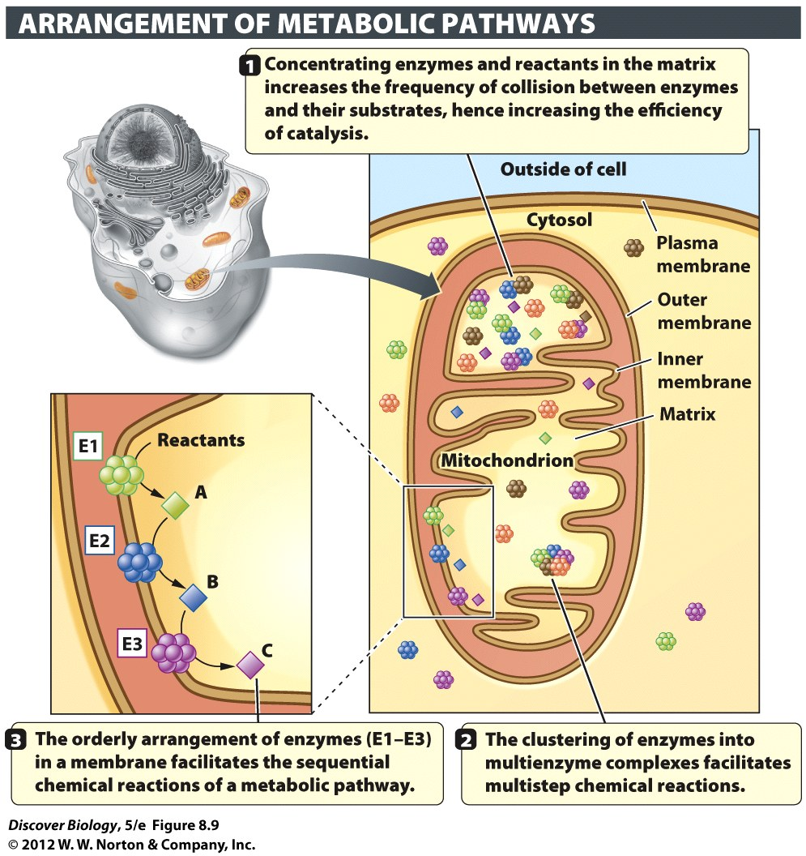
Reactions can use several enzymes
Multiple steps =
several enzymes arranged into metabolic pathways – chain of reactions
Usually involve enzymes for each step
Products of 1st reaction ➔ substrates of 2nd

Slide 14
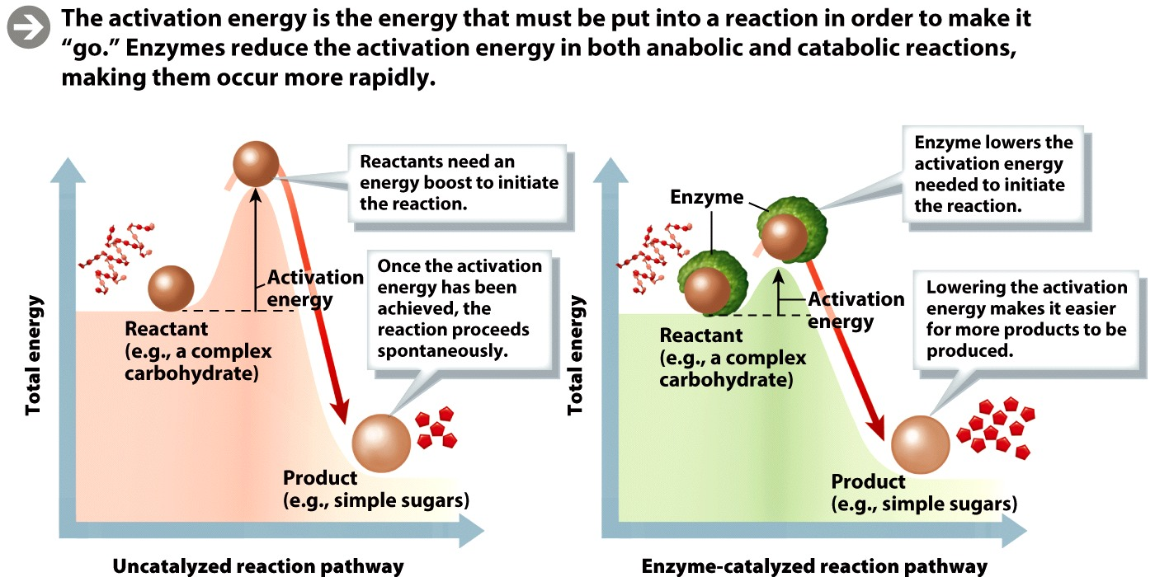
Metabolism: enzymes
Catalysis: the process of speeding up the rate of a chemical reaction (e.g., by enzymes)
Activation energy: energy required for a chemical reaction to start
How do enzymes speed up reaction?
They lower the activation energy
Notes:
Activation energy is the energy that must be put into a reaction in order to make it “go.” Enzymes reduce the activation energy in both anabolic and catabolic reactions, making them occur more rapidly.

Slide 15
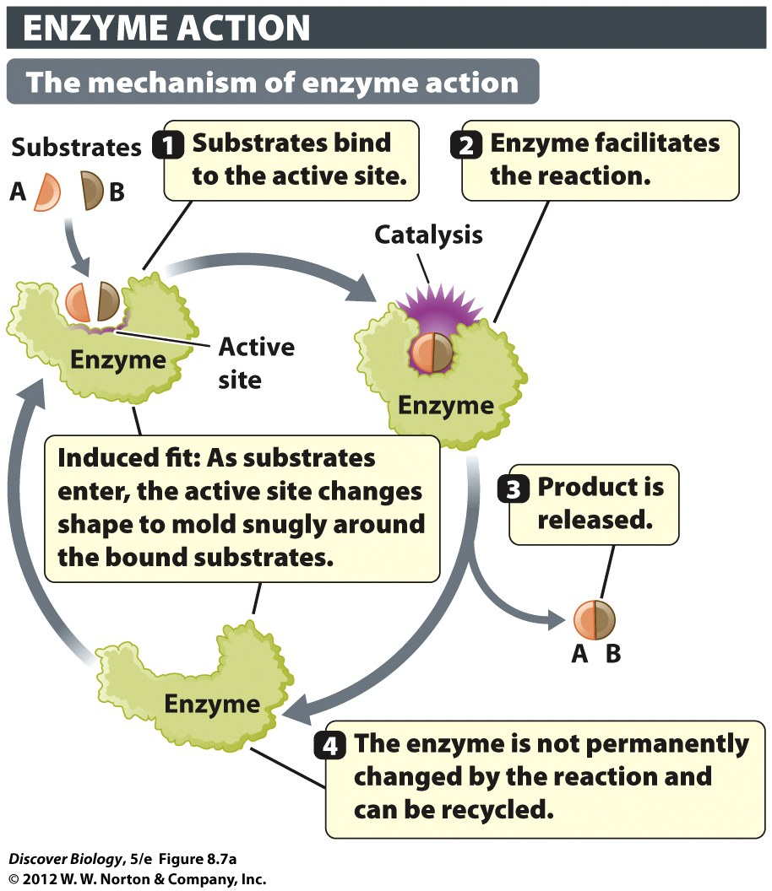
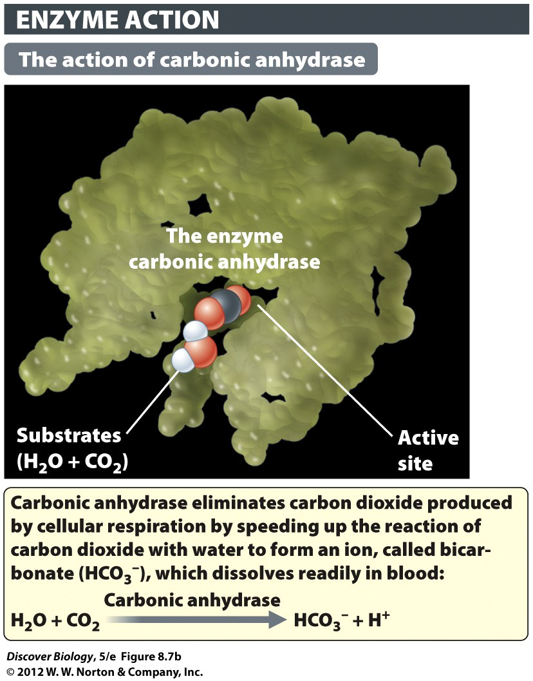
Notes:
Figure 8.7a Enzymes as Molecular Matchmakers
(a) An enzyme brings together two reactants (A and B) to form the product AB.

Slide 16
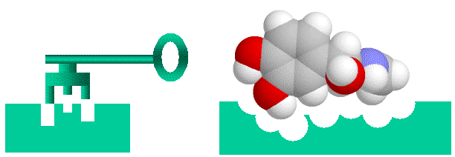
Enzymes: substrate specificity
Enzymes are highly specific catalysts that remain unaltered by a reaction and can be reused
Substrates bind to the active site
Heat, high acidity, and high alkalinity can denature, or destroy, enzymes (shape matters)

Slide 17
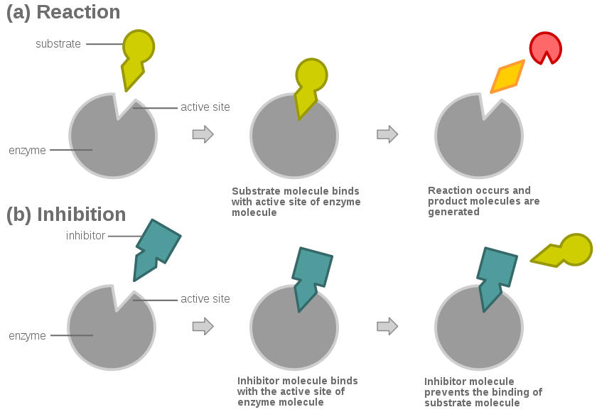
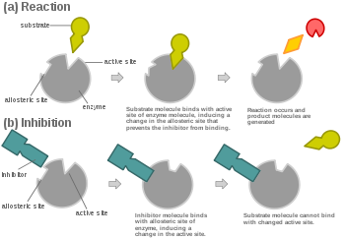
Competitive Inhibition
Inhibitor competes with substrate
Allosteric Inhibition
Inhibitor binds to enzyme, causing change in shape of active site

Slide 18
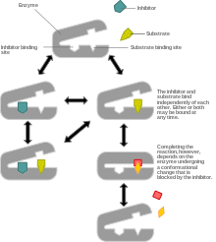
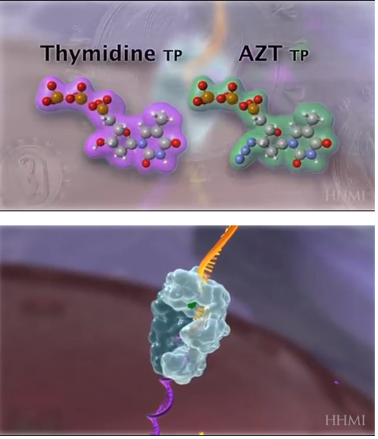
inhibitors can also stop enzyme from functioning
If enzyme changes shape, stop it
HIV’s reverse transcriptase
Drug AZT stops reverse transcriptase

Slide 19
Macronutrients
Nutrients that organisms must ingest in large amounts to maintain health
Carbohydrates, proteins, lipids (fats)

Slide 20
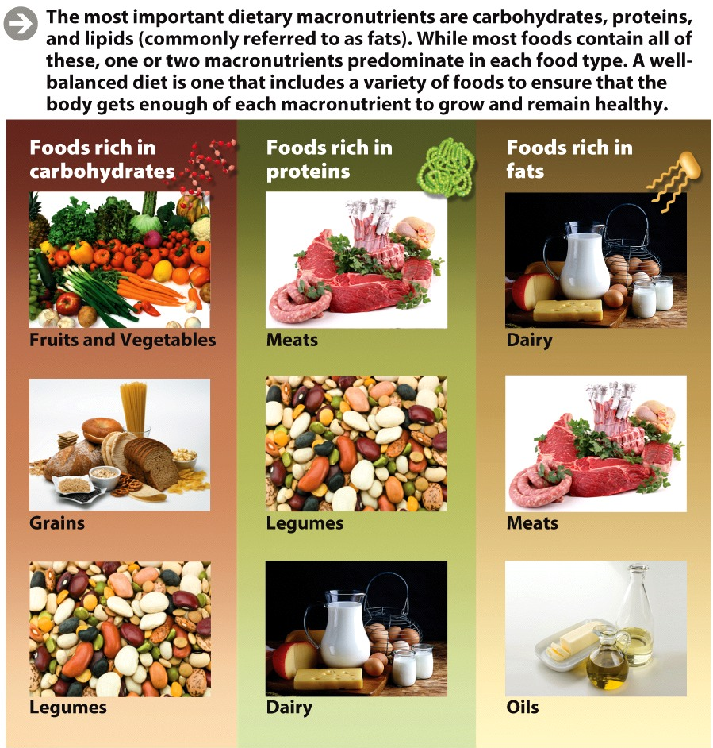
Food provides macronutrients
Carbohydrates
Fats
Proteins
Nucleic acids
No energy

Slide 21
Food provides macronutrients
Many foods contain all three types of macronutrients
The proportion of each one varies in different foods
Animal products contain more protein per gram than carbohydrate
Most plant products contain more carbohydrate than protein

Slide 22
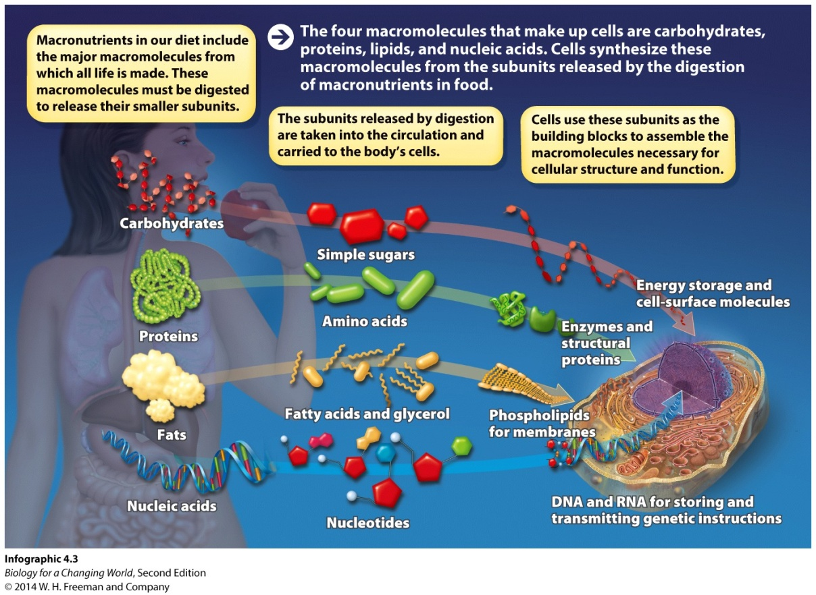
Macronutrients are large molecules
Provide our cells with building blocks
Cannot be used directly from diet
Must be broken down into smaller units
Use subunits as building blocks or energy
Process is digestion

Slide 23
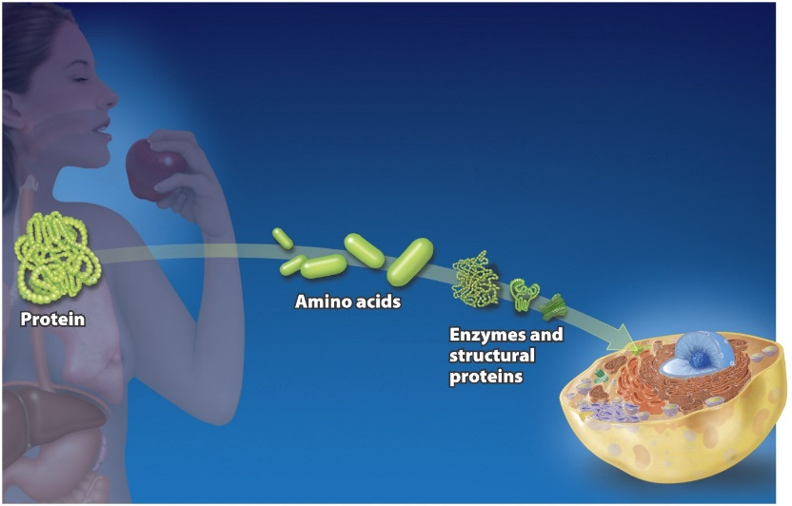
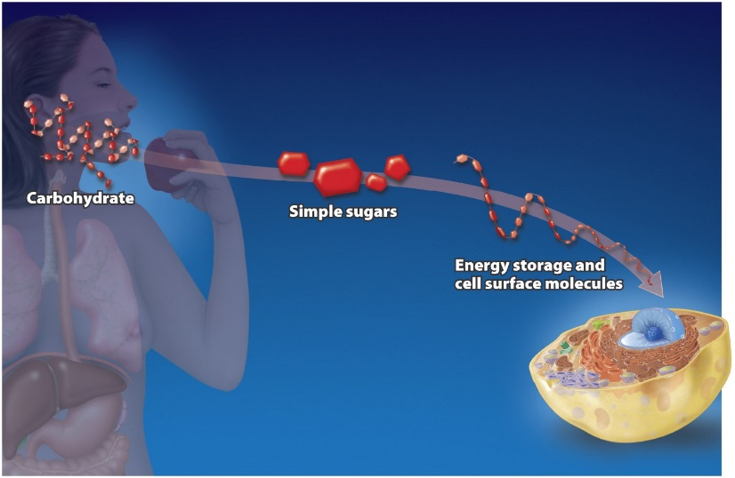
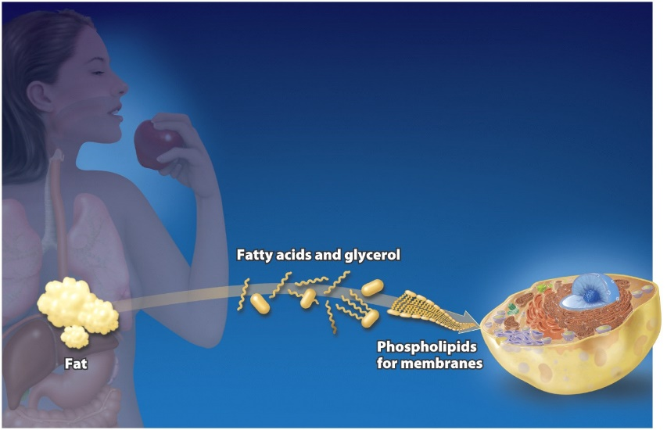
Macronutrients: common uses
Protein➔amino acid
used in new proteins
Carbs➔simple sugars
used in energy storage
& plasma
Membrane molecules
lipids➔fattys acids &
glycerols
Used in membranes
?
Where are the nucleic acids

Slide 24
Nucleic acids
Nucleic acids are not macronutrients
Provided in small amounts
Broken down into individual nucleotides
Used to build DNA and RNA

Slide 25
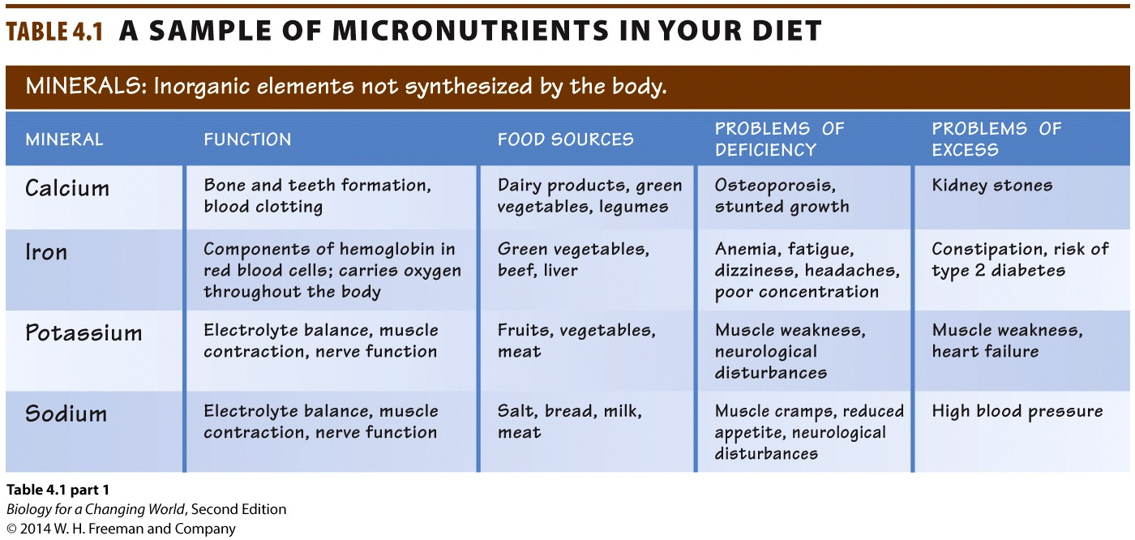
Metabolism: micronutrients
Organisms also need micronutrients
nutrients, including vitamins and minerals, that organisms need in small amounts for health

Slide 26
Micronutrients
Minerals act as cofactors
inorganic micronutrients required to activate an enzyme
zinc, copper, iron
Vitamins act as coenzymes
small organic molecules required to activate enzymes

Slide 27
Micronutrients
Minerals: inorganic elements required by organisms for normal growth, reproduction, and tissue maintenance.
For example: calcium, iron, potassium, zinc
Vitamins: organic molecules required in small amounts for normal growth, reproduction, and tissue maintenance
Play structural and functional roles in the body
Notes:
Bones are made primarily of calcium and phosphorus provided by a healthy diet. Iron deficiency causes a blood disease called anemia, and lack of vitamin C causes a tissue-deteriorating disease called scurvy.

Slide 28
Micronutrients
Notes:
Minerals are micronutrients: nutrients that are essential for health but required in far smaller amounts than macronutrients.

Slide 29
Essential nutrients
Cells cannot synthesize them
Nutrients that must be obtained through diet
Essential amino acids
20 amino acids used to build proteins
Nine cannot be synthesized
Notes:
Some nutrients our bodies can’t manufacture must be obtained pre-assembled from our diet. Animal products such as meat, eggs, fish, and dairy are the richest sources of essential amino acids, but in many places around the globe these foods are luxuries people can’t afford.

Slide 30
Speed of metabolism
highest in youth
metabolic rate (RMR) depends on height and weight, muscle mass, age, and sex

Slide 31
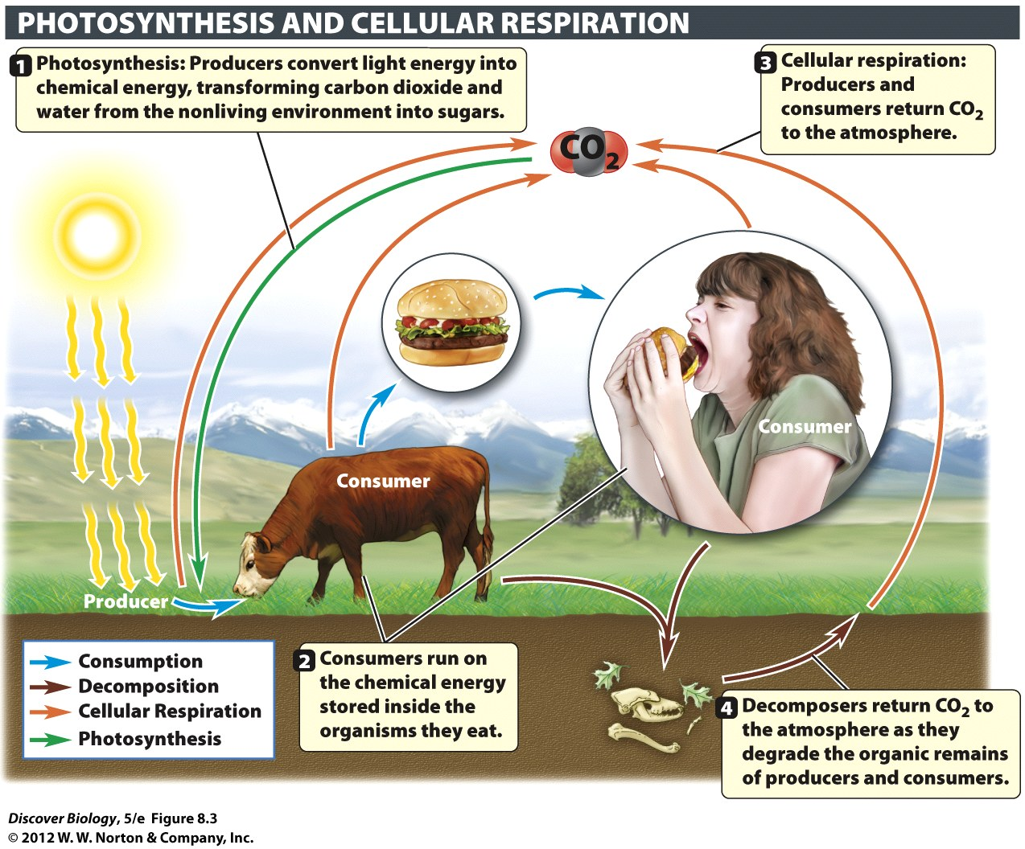
Why does lack of food lead to malnutrition?
Food contains nutrients
Nutrients
The chemical building blocks our bodies need to live, grow, and repair themselves
Provide energy
Energy is the ability to do work
Powers our activities
Helps build complex muscles

Slide 32
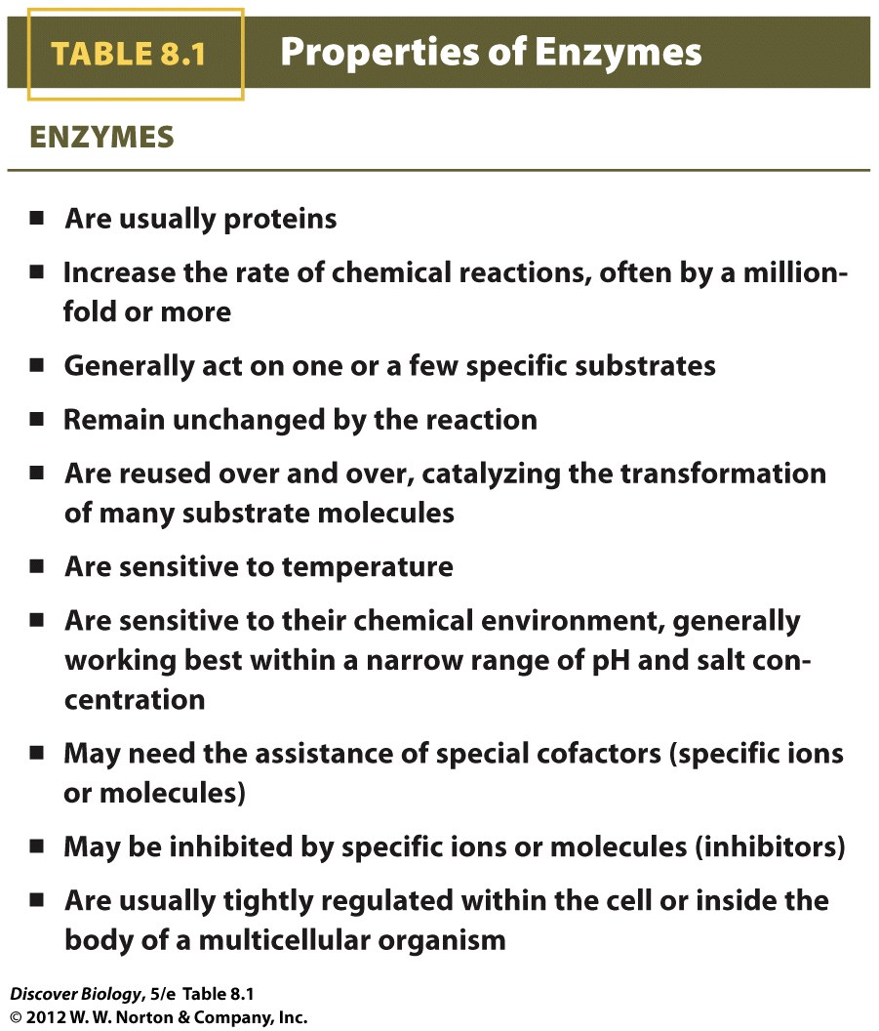
Notes:
TABLE 8.1 Properties of Enzymes

Slide 33
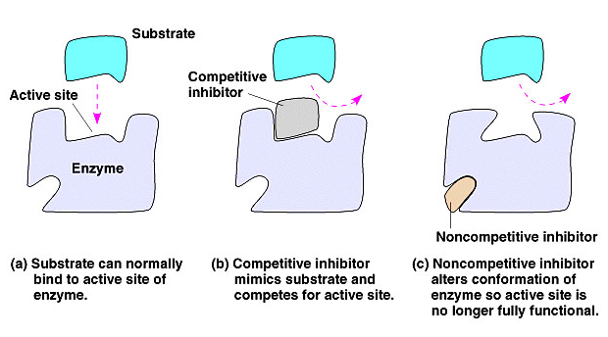
Clicker Questions
CHAPTER 8
Energy, Metabolism,
And Enzymes

Slide 34
Concept Quiz
Which type of reactions cut large molecules apart and release energy?
catabolic
anabolic
Neither answer is correct, since they both require energy

Slide 35
Concept Quiz
Which type of reaction IN CELLS uses enzymes?
catbolic.
anabolic.
both.
Neither.
Notes:
The correct answer is B. High fevers are life-threatening for a long period of time because enzymes begin to denature at higher temperatures.
Lower fevers can actually be beneficial to the body. It is the natural defense mechanism.
Molecules do move faster at higher temperatures, but this answer choice does not address the question.
Microbes may reproduce faster at higher temperatures, up to an optimal temperature. Higher than the optimum, microbes can be destroyed.

Slide 36
Concept Quiz
How do enzymes speed up reactions?
They raise the activation energy.
They lower the activation energy.
They speed up the movement of molecules in a solution.
They slow down the movement of molecules in a solution.
Notes:
The correct answer is B. High fevers are life-threatening for a long period of time because enzymes begin to denature at higher temperatures.
Lower fevers can actually be beneficial to the body. It is the natural defense mechanism.
Molecules do move faster at higher temperatures, but this answer choice does not address the question.
Microbes may reproduce faster at higher temperatures, up to an optimal temperature. Higher than the optimum, microbes can be destroyed.

Slide 37
Concept Quiz
Why do enzymes denature in pH that is higher or lower than normal?
They change shape when their hydrogen bond break.
They move faster than normal.
They move slower than normal.
Extreme conditions destroy their substrate.
Notes:
The correct answer is B. High fevers are life-threatening for a long period of time because enzymes begin to denature at higher temperatures.
Lower fevers can actually be beneficial to the body. It is the natural defense mechanism.
Molecules do move faster at higher temperatures, but this answer choice does not address the question.
Microbes may reproduce faster at higher temperatures, up to an optimal temperature. Higher than the optimum, microbes can be destroyed.

Slide 38
Concept Quiz
Why are high fevers dangerous and
sometimes life‑threatening?
Molecules move faster at higher temperatures.
Enzymes may change shape at high temperatures.
Invading microbes survive better and reproduce faster at high temperatures.
Notes:
The correct answer is B. High fevers are life-threatening for a long period of time because enzymes begin to denature at higher temperatures.
Lower fevers can actually be beneficial to the body. It is the natural defense mechanism.
Molecules do move faster at higher temperatures, but this answer choice does not address the question.
Microbes may reproduce faster at higher temperatures, up to an optimal temperature. Higher than the optimum, microbes can be destroyed.

Slide 39
Concept Quiz
Where a substrate binds to an enzyme is known as the
Active site
Activation energy
Energy transfer site
Notes:
The correct answer is A. The active site is where a substrate binds. The shape of the active site dictates the enzyme’s activity and which substrates may bind to it.
Activation energy is the energy required to start a reaction.
Energy transfer site is listed as a distraction.

Slide 40
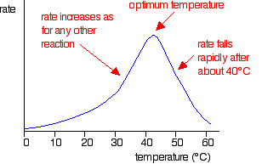
Enzymes: Effect of Temperature
Notes:
Figure 8.9 Metabolic Pathways Are Organized in Ways That Increase Their Efficiency
Enzymes are often arranged in the cell in ways that facilitate the orderly series of chemical reactions that make up a metabolic pathway. These arrangements include the concentration of enzymes in organelles (in this case, a mitochondrion), their localization in membranes, and their clustering in multienzyme complexes.

Slide 41
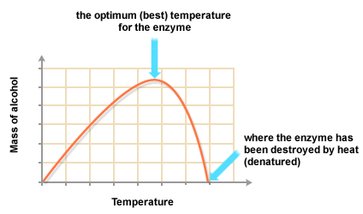
Enzymes: Effect of Temperature
Notes:
Figure 8.9 Metabolic Pathways Are Organized in Ways That Increase Their Efficiency
Enzymes are often arranged in the cell in ways that facilitate the orderly series of chemical reactions that make up a metabolic pathway. These arrangements include the concentration of enzymes in organelles (in this case, a mitochondrion), their localization in membranes, and their clustering in multienzyme complexes.

Slide 42
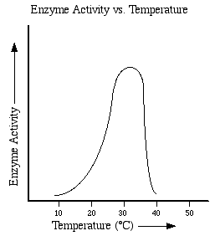
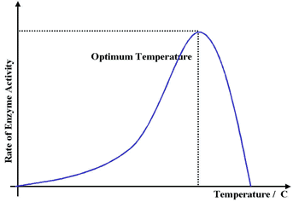
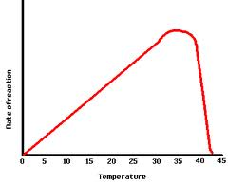
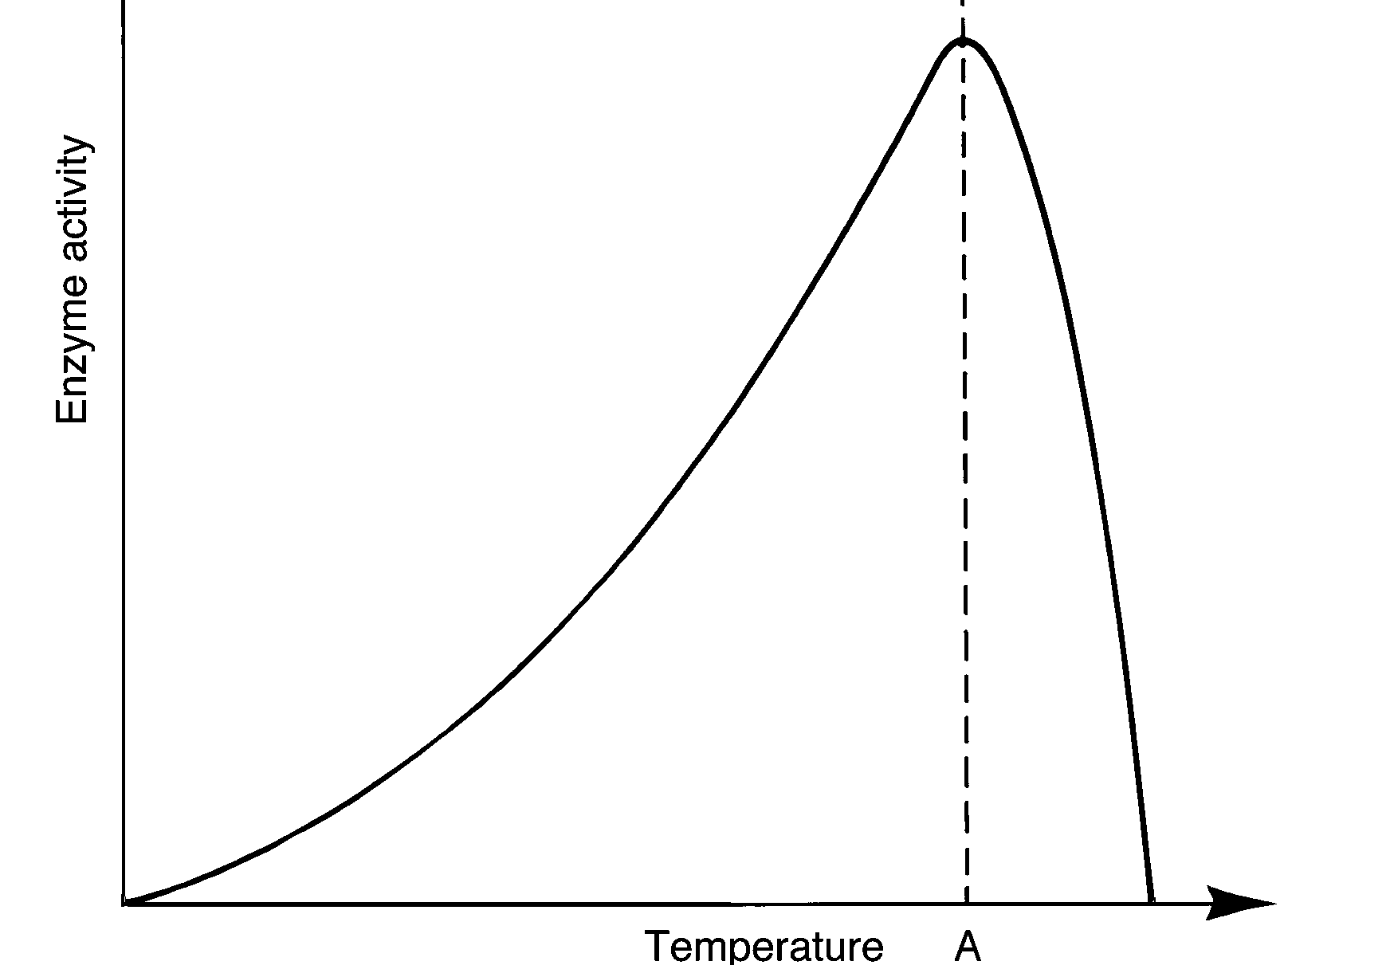
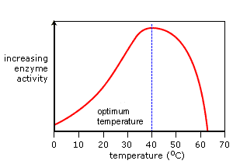

Slide 43
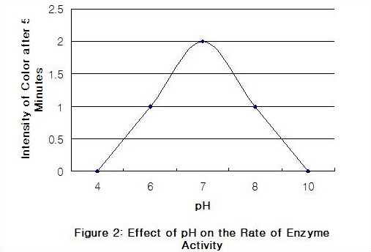
Enzymes: effect of pH
Notes:
Figure 8.9 Metabolic Pathways Are Organized in Ways That Increase Their Efficiency
Enzymes are often arranged in the cell in ways that facilitate the orderly series of chemical reactions that make up a metabolic pathway. These arrangements include the concentration of enzymes in organelles (in this case, a mitochondrion), their localization in membranes, and their clustering in multienzyme complexes.

Slide 44
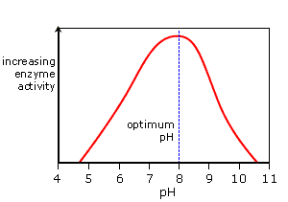
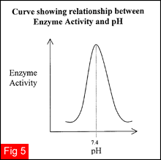
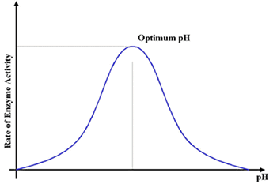
Notes:
Figure 8.9 Metabolic Pathways Are Organized in Ways That Increase Their Efficiency
Enzymes are often arranged in the cell in ways that facilitate the orderly series of chemical reactions that make up a metabolic pathway. These arrangements include the concentration of enzymes in organelles (in this case, a mitochondrion), their localization in membranes, and their clustering in multienzyme complexes.

Slide 45
Enzymes: Effect of Concentration
Notes:
Figure 8.9 Metabolic Pathways Are Organized in Ways That Increase Their Efficiency
Enzymes are often arranged in the cell in ways that facilitate the orderly series of chemical reactions that make up a metabolic pathway. These arrangements include the concentration of enzymes in organelles (in this case, a mitochondrion), their localization in membranes, and their clustering in multienzyme complexes.

Slide 46
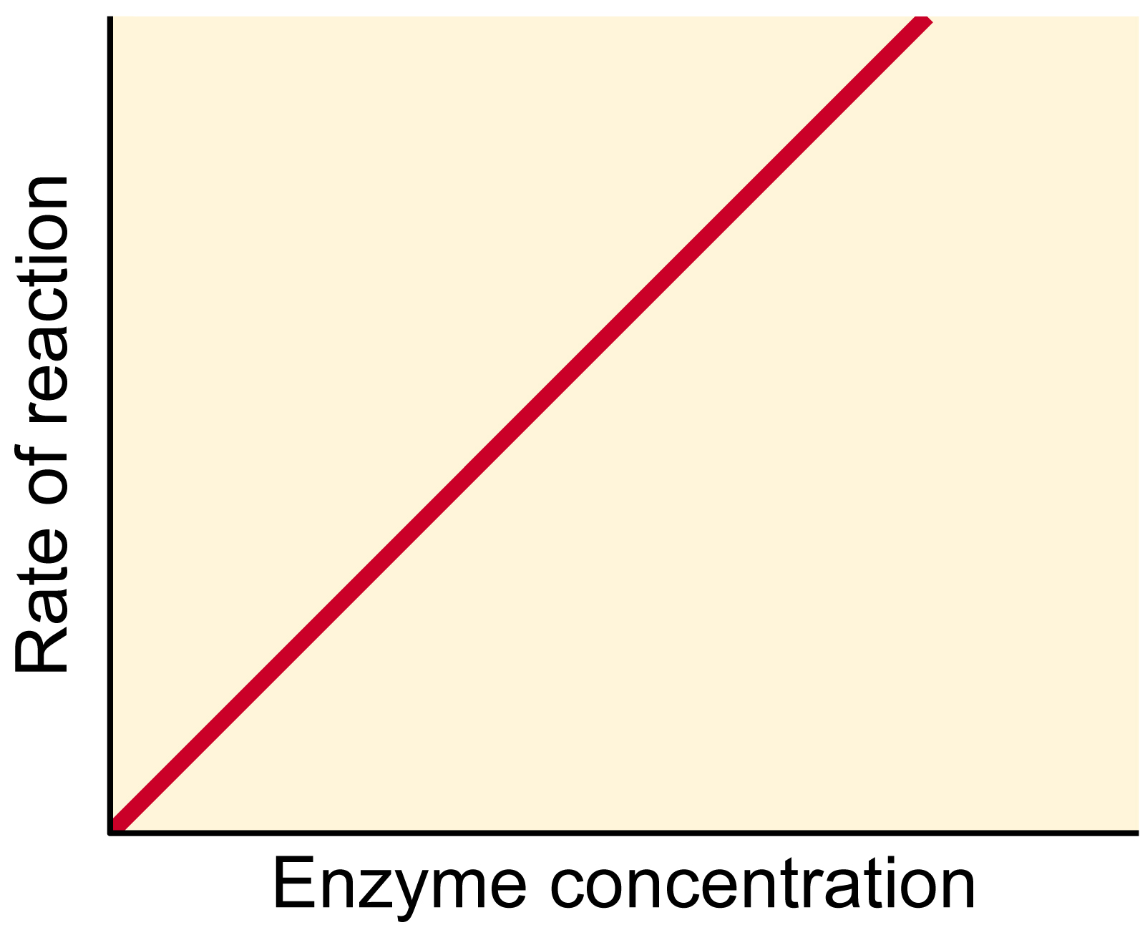
Notes:
Figure 8.9 Metabolic Pathways Are Organized in Ways That Increase Their Efficiency
Enzymes are often arranged in the cell in ways that facilitate the orderly series of chemical reactions that make up a metabolic pathway. These arrangements include the concentration of enzymes in organelles (in this case, a mitochondrion), their localization in membranes, and their clustering in multienzyme complexes.

Slide 47
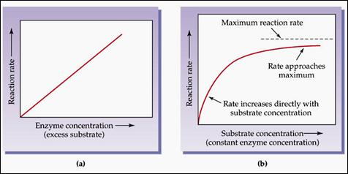
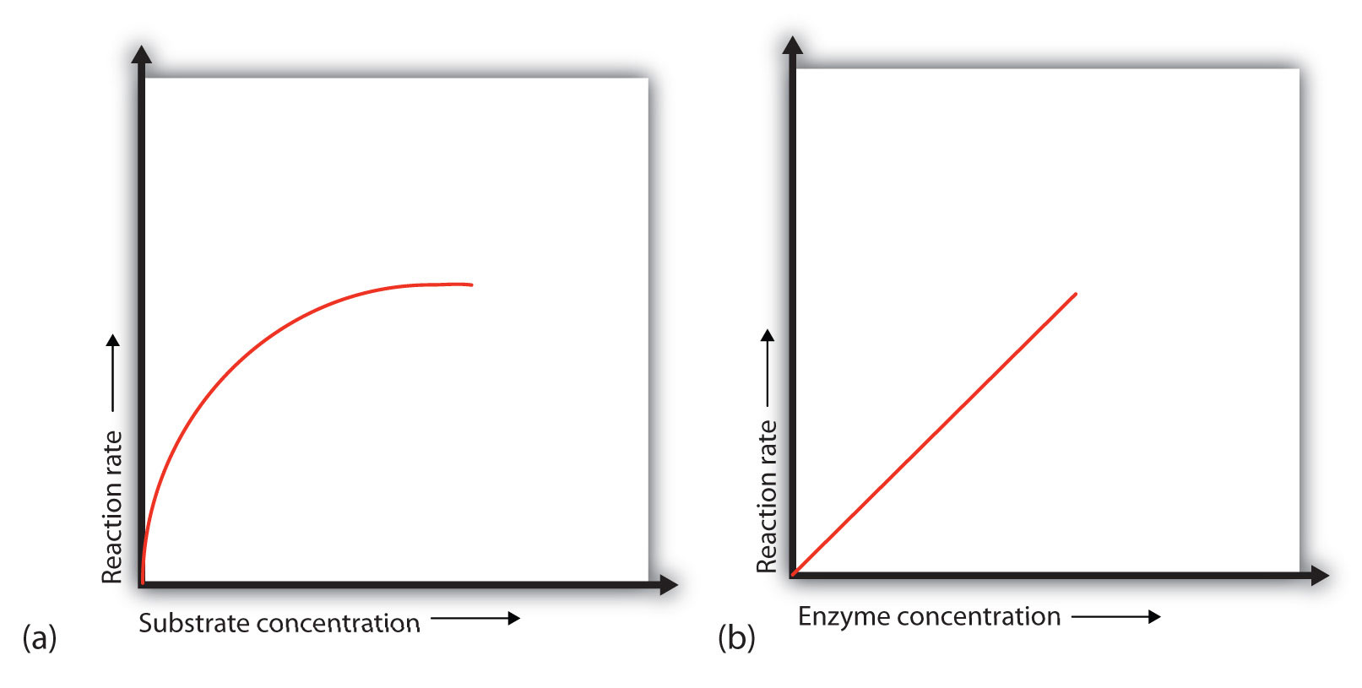
Notes:
Figure 8.9 Metabolic Pathways Are Organized in Ways That Increase Their Efficiency
Enzymes are often arranged in the cell in ways that facilitate the orderly series of chemical reactions that make up a metabolic pathway. These arrangements include the concentration of enzymes in organelles (in this case, a mitochondrion), their localization in membranes, and their clustering in multienzyme complexes.

Slide 48
Free Biology Tutoring
Not Happy with your grade?
Not understanding the material?
Remember that the TLCC has

