Slide 1
Free Biology Tutoring
Not Happy with your grade?
Not understanding the material?
Remember that the TLCC has

Slide 2
Michèle Shuster • Janet Vigna • Matthew Tontonoz • Gunjan Sinha
Biology for a
Changing World
SECOND EDITION
Lecture PowerPoint
CHAPTER 2
Chemistry and Molecules of Life
Copyright © 2014 by W. H. Freeman and Company

Slide 3
Stuff you should be able to answer
How is matter organized into molecules of living organisms?
What is the definition of life, and how could Martian life be recognized?
What is the basic structural unit of life?
Why is water so important for life and living organisms?

Slide 4
All living things have six functional traits in common
Growth
Reproduction
Homeostasis
Sense and respond to stimuli
Ability to obtain and use energy
Uses DNA to store genetic information

Slide 5
six functional traits in all living things
Growth: the process of increasing in size
Reproduction: the process of producing new organisms

Slide 7
six functional traits in all living things
Homeostasis: the maintenance of a relatively constant internal environment
Ability to obtain and use energy; allowing them to do work

Slide 8
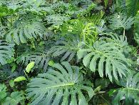
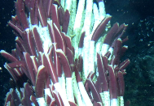
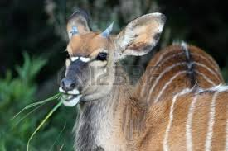
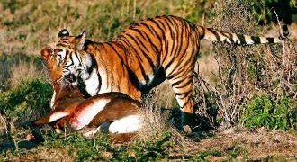
Energy from environment or food
12H₂S + 6CO₂ → C₆H₁₂O₆ (=carbohydrate) + 6H₂O + 12S
Producers (autotrophs) make own food
Photosynthesis pea aphids!!!
Chemosynthesis (rare, but awesome!)
Consumers (heterotrophs) eat other living things

Slide 9
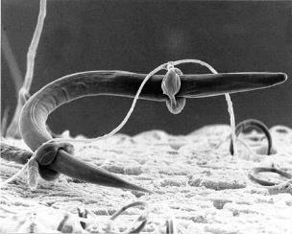
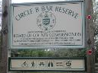
six functional traits in all living things
Sense and respond to stimuli: ability to react to their environment
Why do organisms need to sense and respond to conditions in their body and environment?
Goal: Homeostasis
(Constant internal conditions)
Dodder vine!!!
Fungi trapping and eating a nematode worm ➔

Slide 10
#6 – living thing use DNA
six functional traits in all living things
Deoxyribonucleic Acid (yes, be able to spell it)
If a cell has a nucleus, that’s where the DNA should be
“gene” – part of a DNA molecule with instructions for a genetic trait
“Chromosome” – very big DNA molecule (has many genes)
Unambiguous, redundant, mostly universal

Slide 11
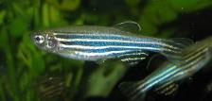
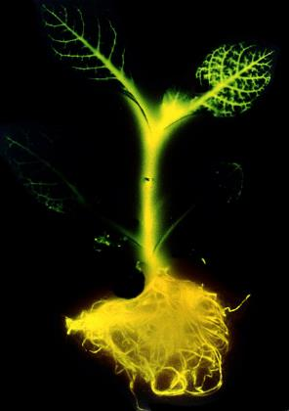
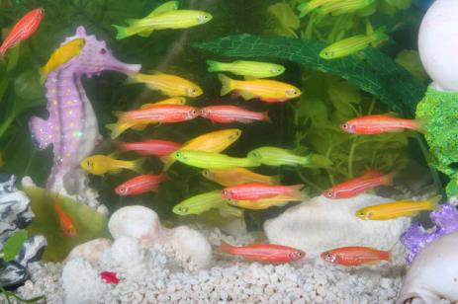
DNA - universal
variations of the same basic genetic code
slight differences, but close enough to do this!!!

Slide 12
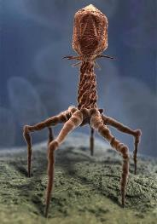
Why viruses are not “alive”
Growth
Reproduction (need host to do it)
Homeostasis
Sense and respond to stimuli (probably not)
Ability to obtain and use energy

Slide 13
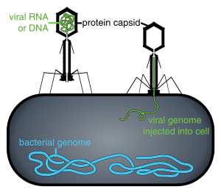
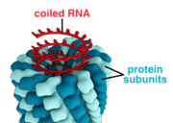
At least two parts in all viruses
Nucleic acid core
Protein coat
Many viruses also have capsule made of membranes stolen from their host cell

Slide 14
Nerd Words
Metabolism: sum total of all chemical reactions occurring in living things
Goal: organisms need to obtain energy to power their bodies

Slide 15
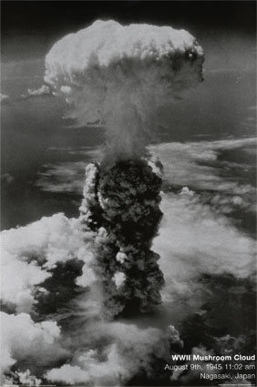
All life is composed of the same chemical building blocks
Matter
takes up space
has mass
elements
Can’t be chemically broken down
Yes, we can use physics, but that turns some of the mass into energy, and tends to be messy

Slide 16
“essential elements”
25 essential elements (ones needed for life)
Carbon, hydrogen, oxygen and nitrogen make up 96% of living organisms

Slide 17
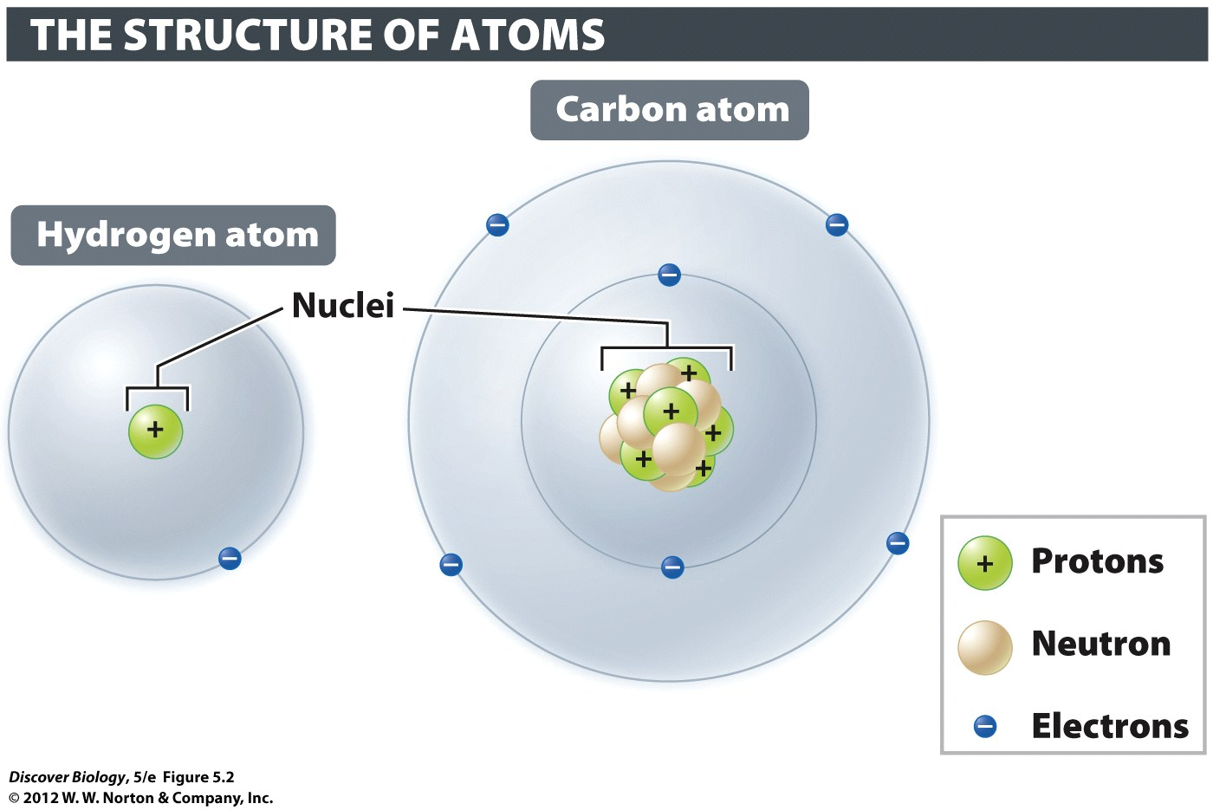
Atom
Smallest piece of element that acts like larger amounts
Only three particles matter in biology
most atoms are neutral: protons = electrons

Slide 18
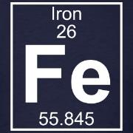
Nucleus: middle of atom
Average mass for
this type of atom
Where mass is!!
Made of protons and neutrons

Slide 19
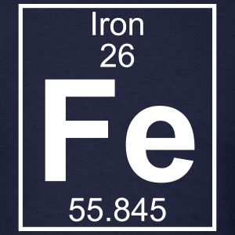
Protons: Positively Charged
Number of Protons
Protons
positive charge
In the nucleus
one mass unit
If atom has no charge, protons = electrons

Slide 20
Neutrons: Neutral (No charge)
Mass of an atom – number of protons = number of neutrons
Neutrons
no charge
In the nucleus
one mass unit

Slide 21
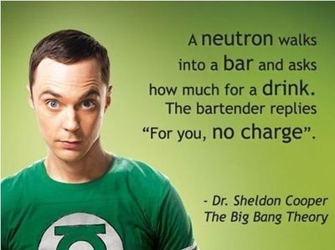

Slide 22
All life is composed of the same chemical building blocks
The periodic table of elements represents all known elements on Earth
Mendeleev was awesome
Reports atomic number (# of protons) and atomic mass
Notes:
Each element is placed in order by its atomic number, the number of protons found in the nucleus of its corresponding atom.

Slide 23
All life is composed of the same chemical building blocks
Atomic number
# of protons
Atomic mass
protons + neutrons

Slide 24
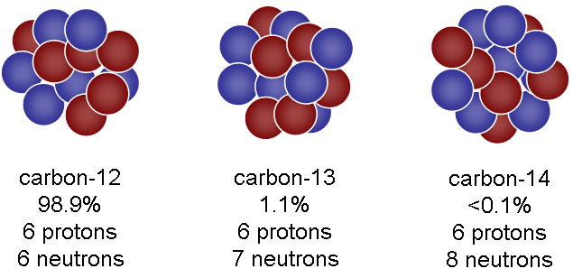
Isotopes – atoms with different masses
Atomic mass = protons + neutrons (electrons are so small we ignore them)
All have the same number of protons (that’s why they are the same element)
#of neutrons varies

Slide 25
Understand the numbers
“mass of most common isotope” = round the average mass (for iron, 56 mass units)
“atomic number” = protons

Slide 26
Isotopes & Neutrons
Average mass of an atom
Mass of an isotope
Mass – protons = neutrons

Slide 27
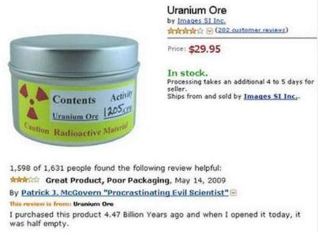
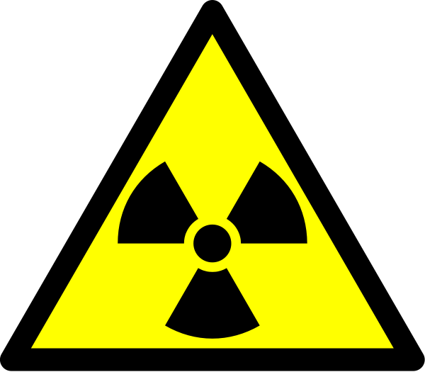
Some isotopes are unstable (Atoms of this isotope fall apart easily)
When atoms break down, part of them will become an atom of a new element, but part of them will become radioactive energy

Slide 28
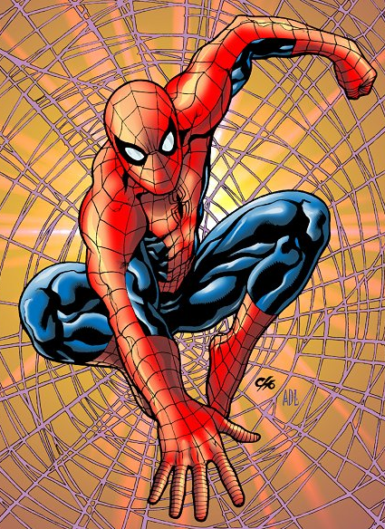
Radioactive stuff is useful!!!
(but not this way)

Slide 29
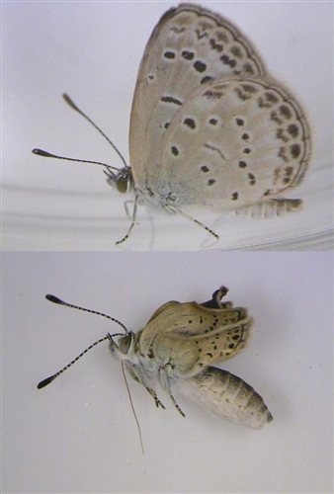
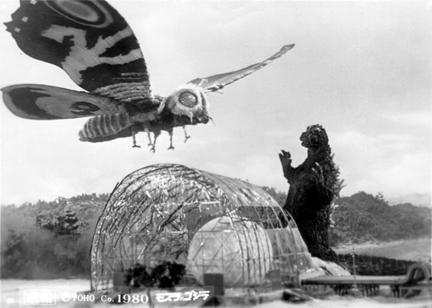
Mutant Butterfies in Japan

Slide 30
Electrons: negative charge
Electrons
negative charge
Orbit nucleus
NO MASS
(well, so little that we ignore it)
Outer layer of electrons (valence layer) determines the properties of the atom

Slide 31
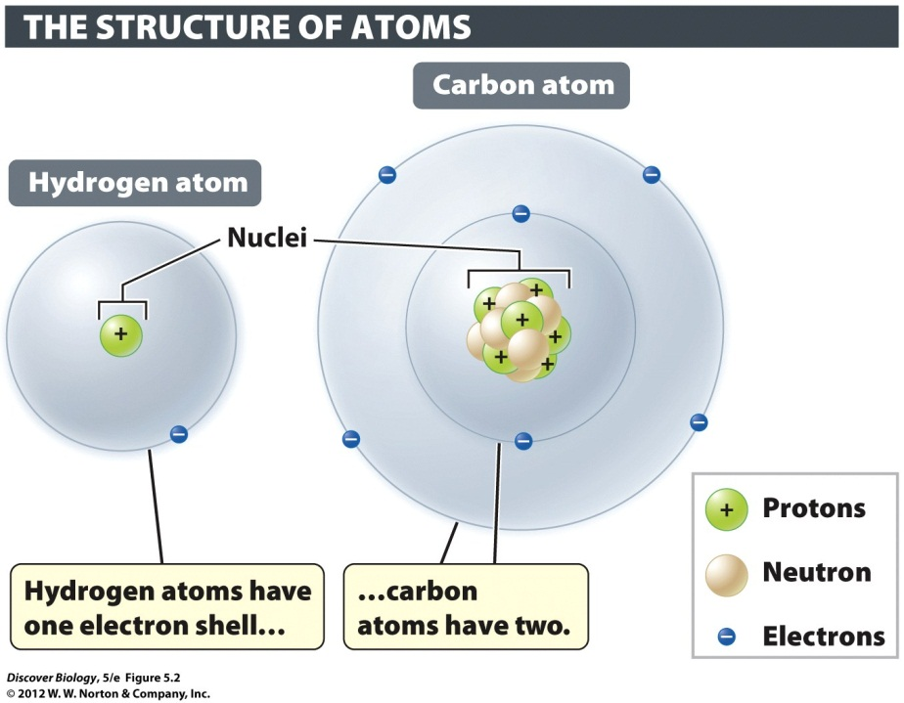
Energy Levels of Electrons
Around the nucleus
in layers like onion
Layers = “shells”

Slide 32
Energy Levels of Electrons
Big orbit = more energy
“energy layer” or “electron shell”

Slide 33
Energy Levels
arrangement of electrons = chemical properties
“Valence electrons”
# of valence electrons is most important chemical property

Slide 34
Valence Electron Layers
Atoms want full, empty, or eight electrons
DO NOT WRITE LAYERS!!!!
Layer 1 = Maximum of 2
Layer 2 = Maximum of 8
Layer 3 = Maximum of 18
Layer 4 = Maximum of 32
Layer 5 = Maximum of 32
Layer 6 = Maximum of 18

Slide 35
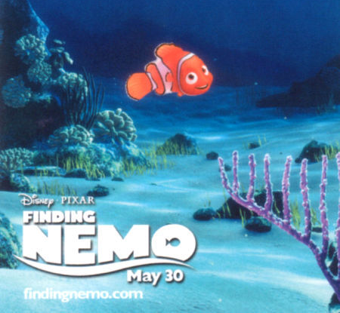

Slide 36
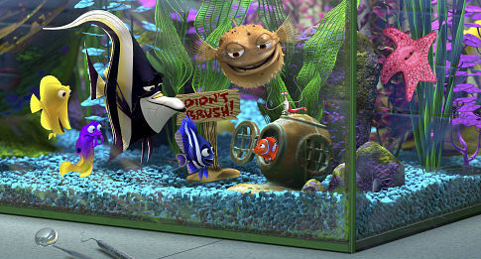
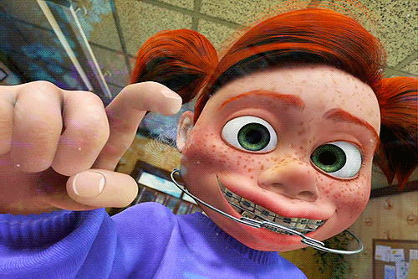
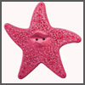

Slide 37
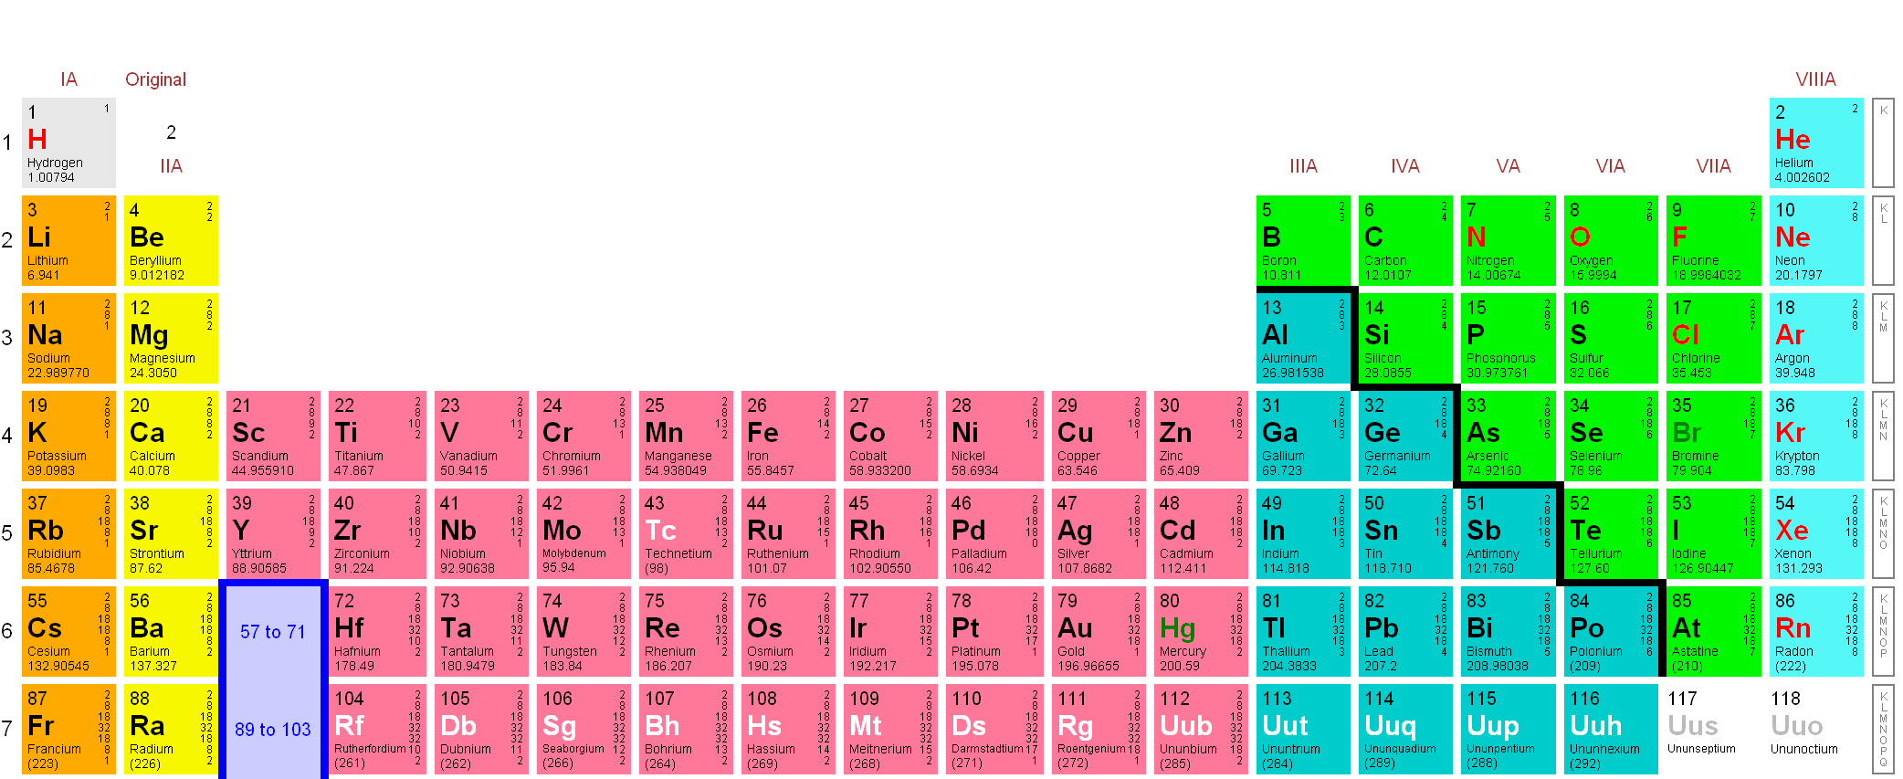
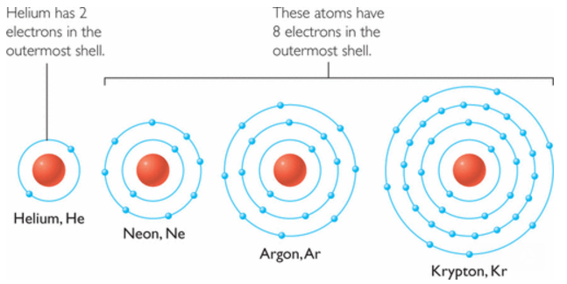
Very electronegative
Valence
layer
Valence
layer
Valence = Full or eight

Slide 38
Mixture (vs. compound)
Mixture
Two or more substances together
Amounts may vary
Compounds (chemical bonds)
Two or more elements together
Fixed ratio (always the same ratio)
Emergent properties – behavior of compound may be drastically different than the behavior of the individual elements

Slide 39
Strong Chemical Bonds
Strong chemical bonds are about trying to get everyone to a happy valence number
Trying to get to full, empty or eight
Ionic: taking or giving electrons
Covalent: sharing electrons

Slide 40
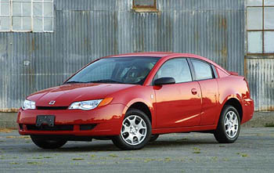
Ions: Atom with charge
most atoms are neutral: protons = electrons
If electrons != protons, atom has charge, and we call it an “ion”
not one of these ➔
(you knew I would make a car joke)

Slide 41
Types of Ions
“Cation” = positive charged ion (protons > electrons)
“Anion” = Negative charged ion (protons < electrons)
Opposite charges attract

Slide 42
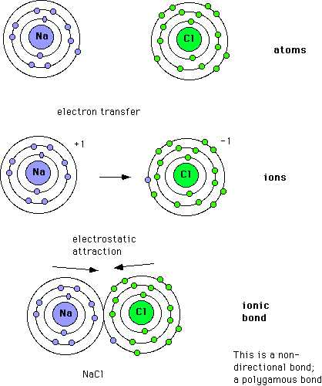
Ionic Bonds
Electron exchange creates a charge
Opposites charges attract
“salts”

Slide 43
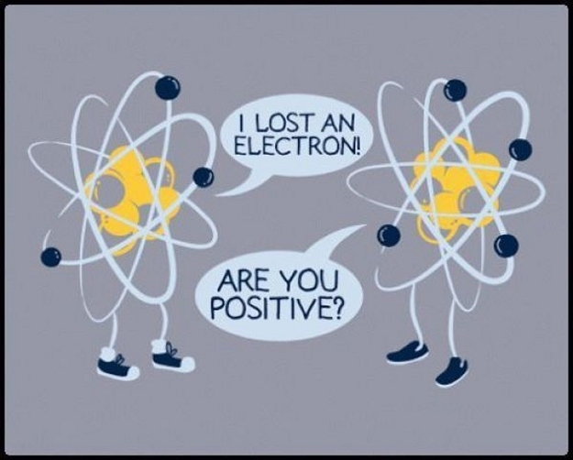
Chemistry Humor

Slide 44
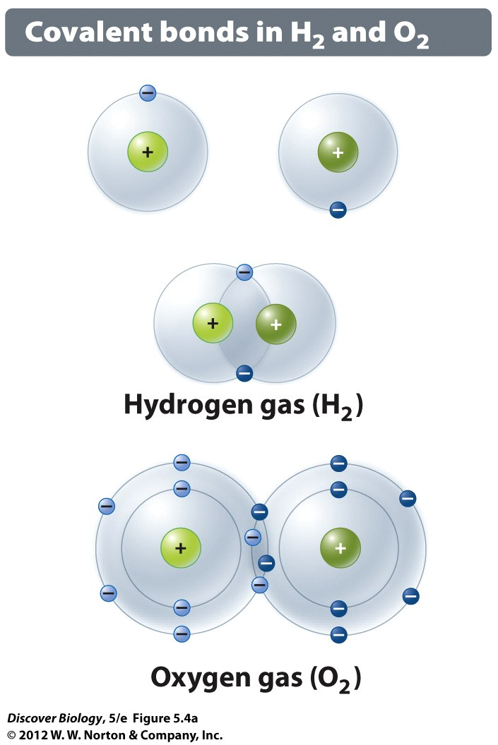
Covalent Bonds: Sharing Electrons
strong
“single”, “double” or “triple”
# of shared electrons
“molecules”

Slide 45
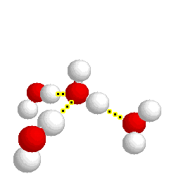
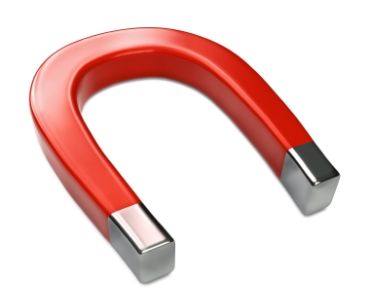
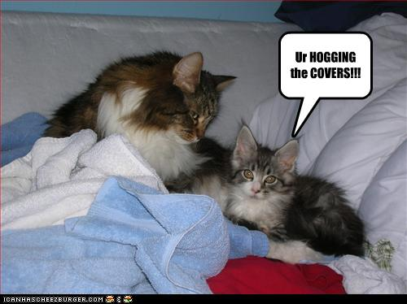
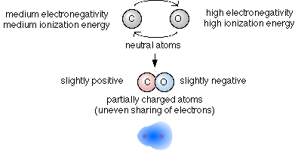
Polar Covalent Bonds
Charged
electronegative end hogs electrons

Slide 46
Weak Chemical Bonds
Temporary attractions between atoms or molecules
1) Hydrogen bonds – ULTRA important in protein shape SHAPE IS EVERYTHING
2) Van der waals – why geckos are cool??

Slide 47
Weak Chemical Bonds
Hydrogen bonds
hydrogen is NOT electronegative
Often positively charged
Opposite charges attract

Slide 48
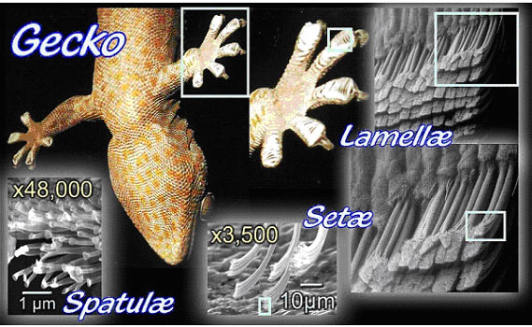
Weak Chemical Bonds
Van der Waals bonds – non-polar, temporary
Geckos love honey-nut cheerios

Slide 49
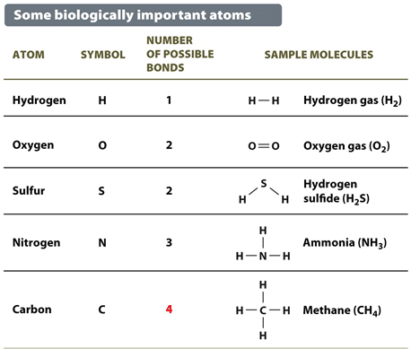
Biologically Important Atoms
Know the first three columns. You will see this again!

Slide 50
All life is based on carbon!!!
(That we know of)
Carbon
fourth most common element in the universe
second most common element in human body
One of six elements that make up most of humans
Oxygen (65%)
Carbon (18.5%)
Hydrogen (9.5%)
Nitrogen (3.3%)
Phosphorus and sulfur (2%)

Slide 51
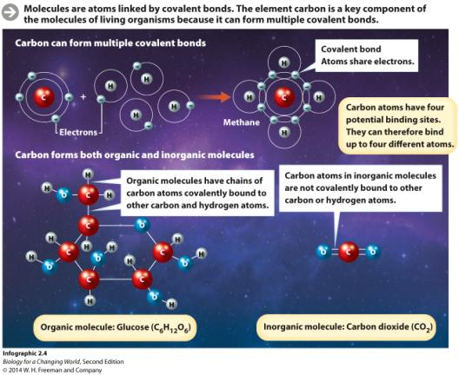
Carbon wants four bonds that are covalent
Carbon is a key component of the molecules of living organisms
It can form multiple covalent bonds, the sharing of a pair of electrons between two atoms
Will explain bond types
Notes:
Strong chemical bonds

Slide 52
Carbon is a versatile component of life’s molecules
Molecules form when atoms are linked by covalent bonds
Carbon atoms can bond up to four atoms

Slide 53
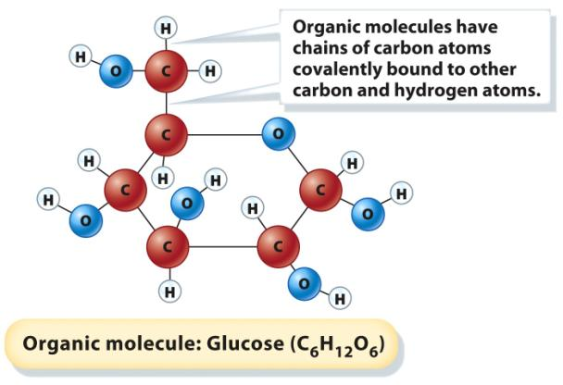
Carbon-carbon bonds: seen in life’s molecules
Organic molecules have carbon-based backbones and at least one C-H bond
Carbon wants to have four bonds

Slide 54
Carbon is a versatile component of life’s molecules
Inorganic molecules lack carbon-based backbones and C-H bonds
Still four bonds
No carbon-carbon bonding

Slide 55
Molecules of life
Macromolecules
Large organic molecules
Composed of subunits called monomers
Monomers link together to form polymer chains

Slide 56
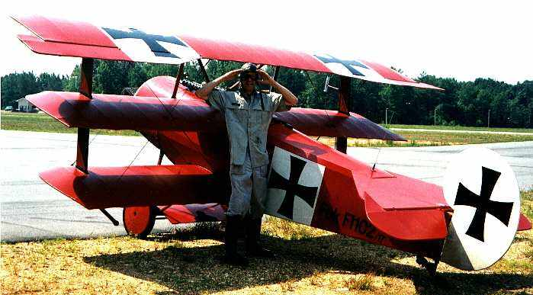
“Mono”
“Bi” or “Di”
“Tri”

Slide 57
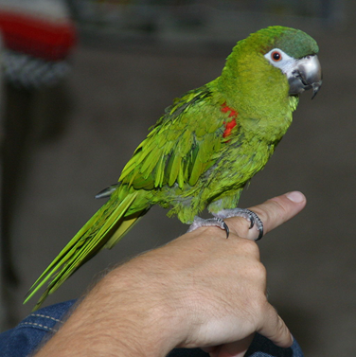
If there are more than three, we usually just say, “Poly”, which is a fancy way to say “there are many”

Slide 58
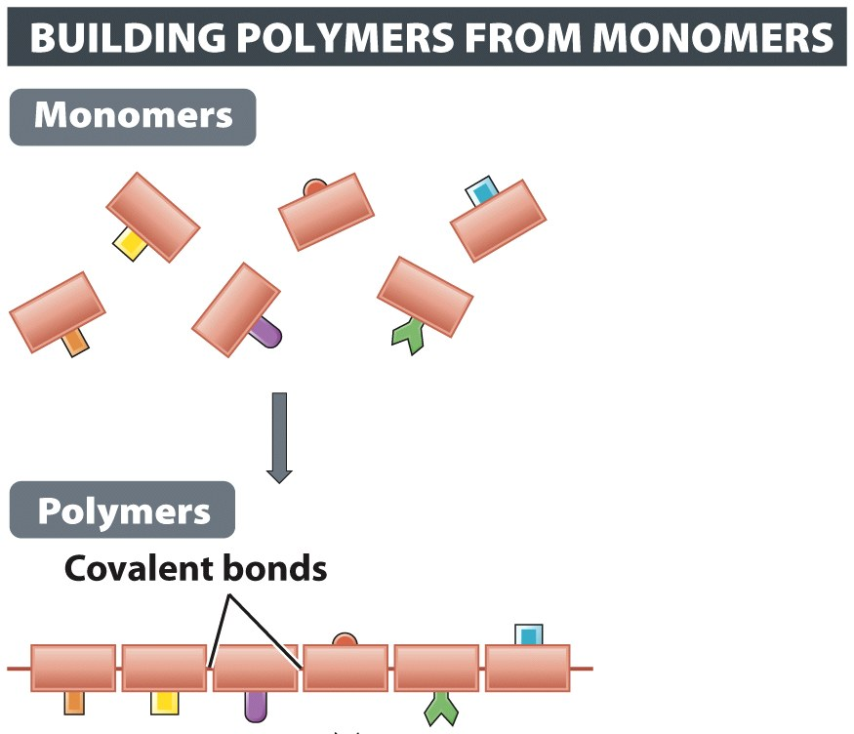
Polymers
One polymer is made from many monomers
Many biological molecules are polymers

Slide 59
Four Macromolecules
Four types of complex macromolecules make up living things
Carbohydrates – sugars, starches, cellulose
Proteins – structural, functional, enzymes
Lipids – Oils, fats, phospholipids, steroids
Nucleic acids – DNA and RNA

Slide 60
Molecules of life: carbohydrates
Carbohydrates are made up of sugar monomers
Notes:
Simple sugars are monosaccharides.

Slide 61
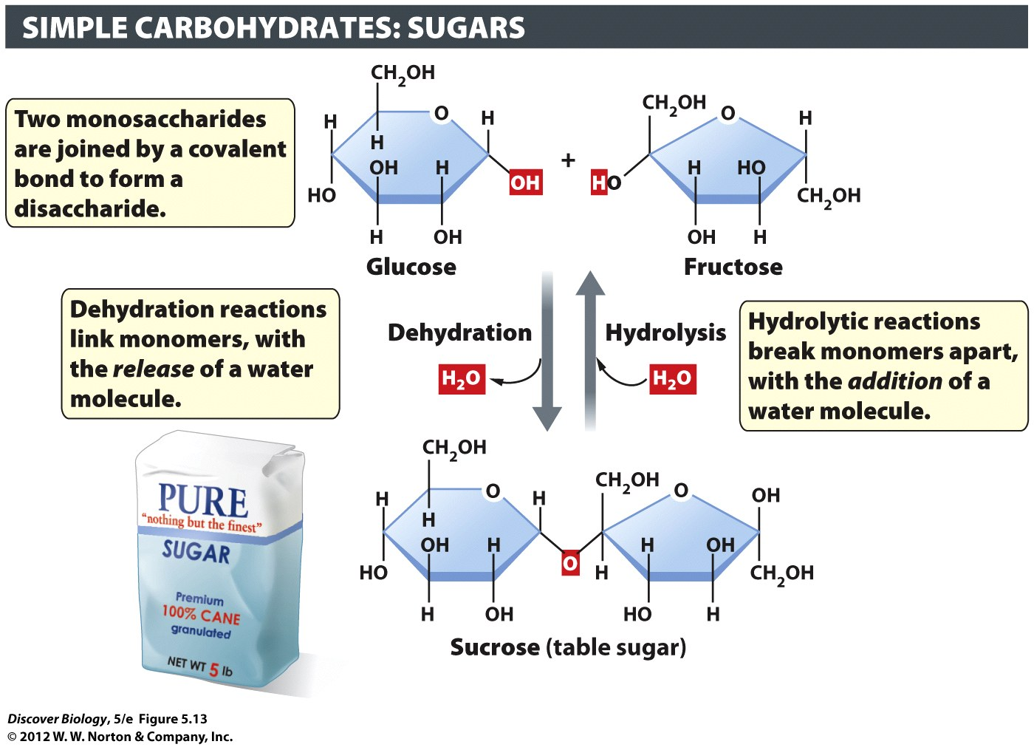
Dehydration
Synthesis

Slide 62
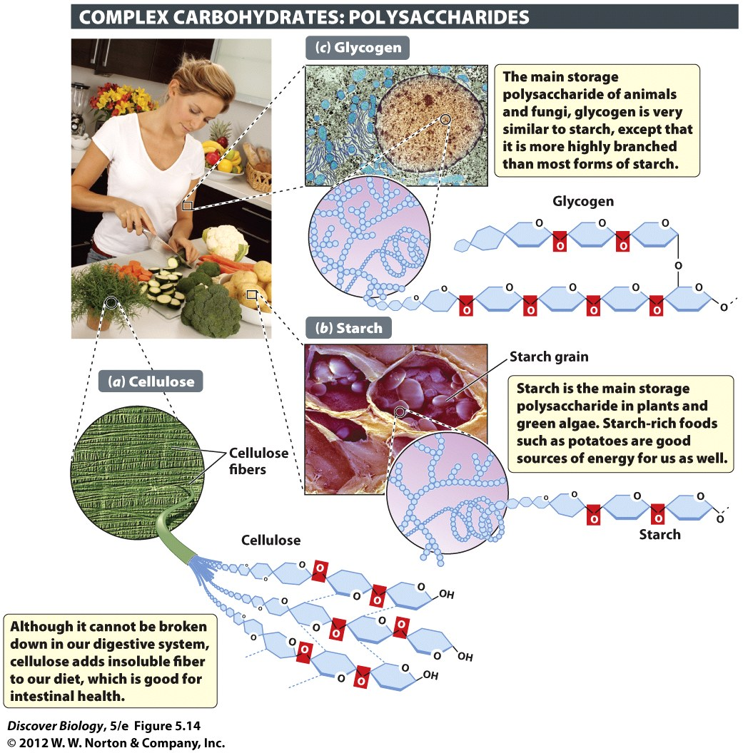
Polysaccharides
“Many” + “sugars”
Cellulose
Polymer of sugar
Walls of plant cells
Hard to digest
Starch
Polymer of sugar
Plant energy storage
Easy to digest
3 natural carbohydrate polymers

Slide 63
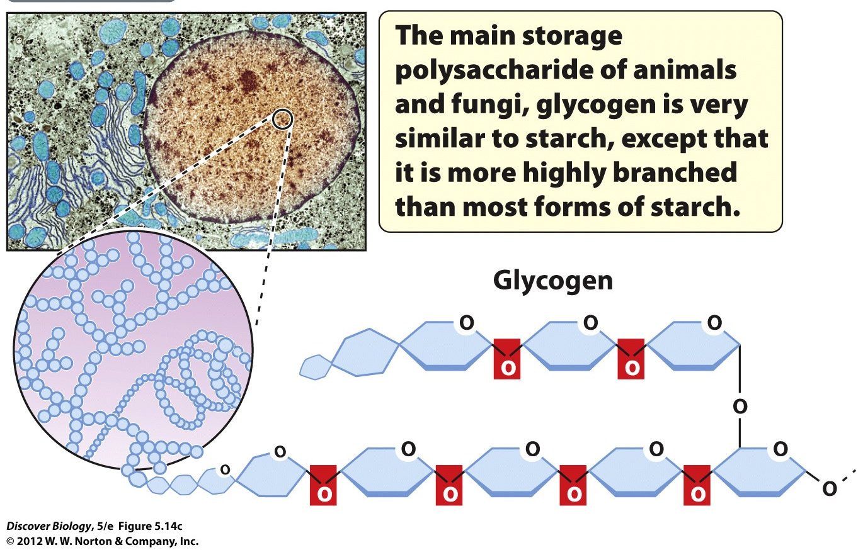
Glycogen
Energy storage in animals and fungi
Another polymer of sugars

Slide 64
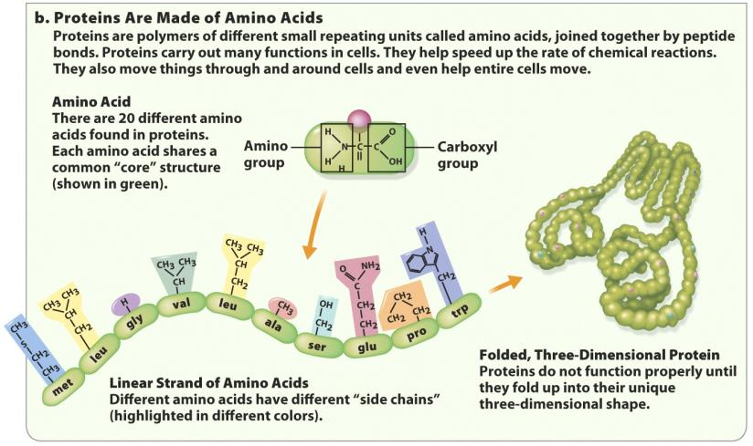
Molecules of life: proteins
Proteins are made up of amino acid monomers

Slide 65
Proteins: made of Amino Acids
Peptide bond – bond between amino acids
Monomer – amino acid
Polymer – polypeptide (“primary structure”) of protein
Proteins – a natural polymer of amino acids
Many types, used by for almost everything

Slide 66
Proteins: Shape matters
Primary
Chain of amino acids
Secondary
Spirals and folds
Tertiary
3-D shape, 1 subunit
Quaternary
Several subunits (parts)

Slide 67
Protein: shape = function
How a protein is shaped controls what it can do
Change the shape = stop working
“denaturing” = changing from natural shape

Slide 68
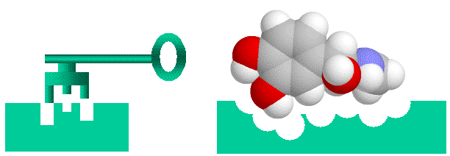
Enzymes: a protein catalyst
Make it easier for a reaction to happen
speed up a reaction
Not altered by reaction
Special shape to fit “substrate” chemical

Slide 69
Enzyme Inhibitors
Competitive: compete with substrate for access to active site
Allosteric:
bind outside the active site
Change shape of enzyme so substrate can’t fit in active site

Slide 70
Denaturing an protein
Changing from their natural shape
Alters their ability to do a job
Usually stops them from working

Slide 71
Molecules of life: nucleic acids
Nucleic acids: polymers of nucleotide monomers
Three parts in nucleotide
Sugar
Phosphate
Nitrogenous base
Usually one strand
Usually two strands

Slide 72
Nucleic Acids: Bases
Backbone = sugar-phosphate
Bases = information

Slide 73
Nucleic Acids
Backbone of strand: sugar-phosphate
RNA: sugar = Ribose
DNA sugar = Deoxyribose

Slide 74
Nucleic Acids
Instructions to make proteins
DNA stays in the nucleus (if eukaryote)
RNA made in nucleus, leaves through nuclear pores

Slide 75
Molecules of life: lipids
Lipids are not made of repeating monomers
Notes:
Lipids are hydrophobic – they don’t mix with water.

Slide 76
Lipids
Fats, phospholipids, steroids
Mostly hydrogen and carbon
Fatty acid chains

Slide 77
Fatty acids
Long hydrocarbon chains
Saturated – filled with hydrogen
Unsaturated – less hydrogen

Slide 78
Fatty Acids:
Saturated (with H)
No double bonds
Molecules pack tightly

Slide 79
Fatty Acids:
Unsaturated
double bonds
Loosely packed
CIS ➔
TRANS ➔

Slide 80
Lipids: Sterols
Used to make Steroids and Cholesterol
We need some cholesterol to make membranes

Slide 81
Phospholipids
Main part of cell membrane
Hydrophilic head
Hydrophobic tails

Slide 82
Phospholipids define cell boundaries
Cells are bounded by a cell membrane
Have a double layer (bilayer)
Separate the contents of a cell from its environment
Notes:
Different types of lipids; all are hydrophobic

Slide 83
Phospholipids define cell boundaries
Phospholipids have a hydrophilic (water-loving) head and hydrophobic (water-hating) tails

Slide 84
The cell
Basic structural unit of life
All cells have some basic architecture
Notes:
Water-filled sacs, bounded by a cell membrane

Slide 85
Water
Proxy for life
All of life’s chemical reactions take place in water

Slide 86
Water
Composed of oxygen and hydrogen atoms
Many of its functions are due to its shape
Notes:
Water is such a good solvent because it is a polar molecule – a molecule in which electrons are not shared equally between atoms – causing a partial negative charge at one end and a partial positive charge at the other.

Slide 87
Water
electronegative
Polar molecule
Electrons not shared equally oxygen hogs electrons!
Partial negative charge at one end and a partial positive charge at the other

Slide 88
105° Bond
Angle lets water bond to many things

Slide 89
Water
Weak attractions, known as hydrogen bonds, with both water and other molecules

Slide 90
Properties of water
Hydrogen bonds give water its unique properties
Cohesion: water molecules cling together
Adhesion: water molecules cling to surfaces
Large liquid range
Solid water is less dense than liquid water, so ice floats

Slide 91
H₂0: Polar dissolves polar well
Why water is good at dissolving things

Slide 92
Solutions
Solute – stuff to dissolve
Solvent – substance to dissolve in
Solution = solute + solvent

Slide 93
Bad Chemistry Joke

Slide 94
Bad at dissolving
non-polar molecules
Water likes polar substances
Hydrophillic vs Hydrophobic
This is why membranes work

Slide 95
Properties of water
Except lipids
Most biological substances dissolve in water
“Universal solvent”: good at dissolving charged stuff
Form hydration shells
(opposites attract)
nearly
Notes:
Water transports all of life’s dissolved molecules, or solutes, from place to place, making life essentially a water-based solution.

Slide 96
Properties of water
Dissolves other polar molecules and substances that contain ionic bonds
Strong bonds formed between oppositely charged ions
Ion: a charged atom due to loss or gain of electron

Slide 97
Properties of water
Water molecules (H₂O) split briefly into separate hydrogen
(H⁺) and hydroxide (OH−) ions.
pH is the concentration of hydrogen ions (H⁺) in a solution
pH ranges from 0 to 14
Notes:
In pure water, the number of separated H⁺ ions is exactly equal to the number of separated OH⁻ ions, and the pH is therefore 7, or neutral.

Slide 98
Properties of water
Acids have a lots of hydrogen
ions (H⁺) and a pH closer to 0
Bases have a very few hydrogen
ions (H⁺) and a pH closer to 14

Slide 99
Buffer
Limits changes in pH
Keeps conditions from getting too acid or too basic

Slide 100
Recap: Types of Chemical Bonds (getting everybody to a happy valence number)
Ionic Bonds = taking or giving electrons
Covalent Bonds = sharing electrons
Weak bonds
Van Der Waals
Hydrogen bonds

Slide 101
Weird “life”?
Many infectious agents and microbes defy our definition of being alive
No
Yes
No
Yes

Slide 102
Summary
Living organisms grow and reproduce, maintain homeostasis, sense and respond to their environment, and rely on energy to carry out their functions.
All matter is composed of elements.
Four types of big biological molecules: proteins, carbohydrates, nucleic acids, and lipids.
All four are carbon-based organic molecules
Living organisms are made of cells, the smallest unit of life.
The concentration of H+ ions in a solution determines its pH.

